Slide 1

SADBHAVNA COLLEGE OF EDUCATION FOR WOMEN, JALALDIWAL
Subject: Understanding the self
Topic: The influence of peer group
Incharge: Ms. Manpreet Kaur

Slide 2
INTRODUCTION
Peers are groups of boys and girls those who are equal in rank i.e. age, background, interests etc. A peer group is an important agency of education.

Slide 3
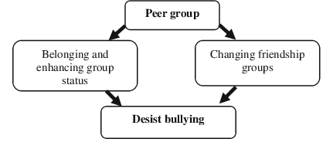

Slide 4

FEATURES OF PEER GROUP
SAME IN RANKING
INDEPENDENCE
NO SUPPRESSION OF FEELINGS
INTEREST AND MOTIVATION
SELF-DEPENDENCE

Slide 5
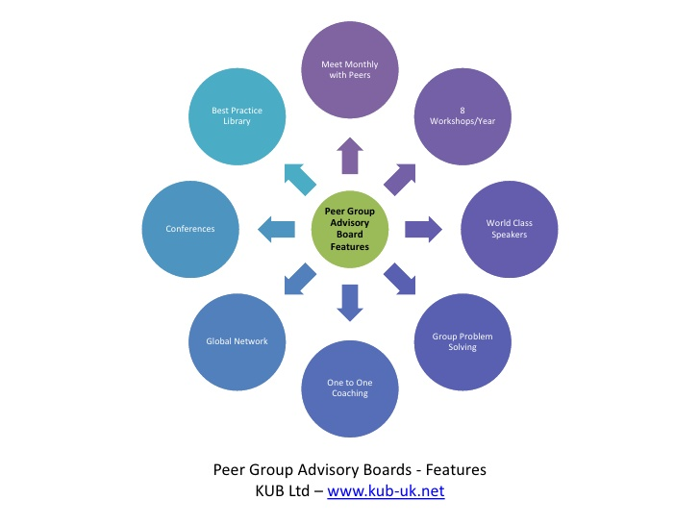

Slide 6

CLASSIFICATION OF PEER GROUPS
PRIMARY PEER GROUP
EARLY PLAY GROUPS
CLIQUES
GANGS
CONSTRUCTIVE GANGS
DESTRUCTIVE GANGS

Slide 7

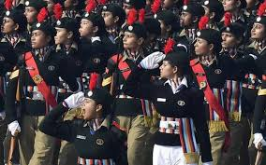
SECONDARY PEER GROUP
THEY ARE FORMED CONSCIOULY AND NOT SPONTANEOUSLY.
They are purely constructive and formed by external agencies like the government and welfare organisations.
NCC
YOUTH CLUBS
YOUTH LEAGUES AND ASSOCIATIONS
JUNIOR RED CROSS SOCIETIES

Slide 8
INFLUENCE OF PEER IN IDENTITY FORMATION
Provides platform for identity formation
Peer group as a source of information
Teach gender roles
Peer group provides group identity
Value based identity
Independent identity
Healthy attitudes in identity

Slide 9
CONCLUSION
Peer relationships provide a unique context for cognative, social, and emotional development.

Slide 10
THANKS

