Slide 1
SADBHAVNA COLLEGE OF EDUCATION FOR WOMEN, JALALDIWAL
Subject: Understanding the self
Topic: The influence of media on identity formation
Incharge: Ms.Manpreet Kaur Raikot

Slide 2
INTRODUCTION
MEANING OF MEDIA
The means of communication that reach large numbers of people, such as television, newspapers and radio.

Slide 3
DIFFERENT TYPES OF MEDIA

Slide 4
INFLUENCE OF MEDIA ON IDENTITY FORMATION
We are often bombarded with news, stories showing the horrors of how media is shaping today’s youth. violence, gender-stereotyping have been cited as ills of modern media outlets.
Media as a source of information help to develop identity
Influencing by media
Learning identity

Slide 5
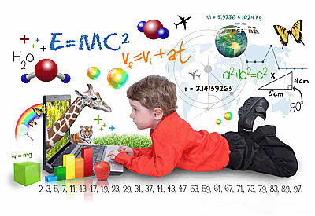
Advertising and healthy identity
Internet in identity development
Social media and identity

Slide 6
MEDIA AND NEGATIVE IDENTITY ASPECTS
Emotionally disturbed children
Children with learning disabilities
Children who are abused by their parents
Continuous watching such violent programme can result in violent identity development.

Slide 7
CONCLUSION
Impact of media on the mental and physical well-being of children and adolescents.
Promote the implementation of high school programs in media awareness, which have proven to be beneficial.

Slide 8
Thanks

