Slide 1

Sadbhavna College of Education for Women , Jalaldiwal
Subject: Understanding the self
Topic: Self Awareness
Incharge: Ms.Manpreet Kaur

Slide 2
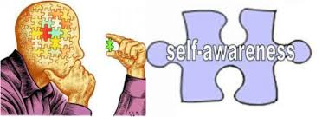
SELF AWARENESS

Slide 3

Self awareness having
a clear perception of your
personality , including
strengths, weaknesses, thoughts
beliefs, motivations and emotions.
Self awareness allows you
to understand other people,
how they perceive you.

Slide 4
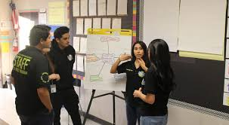

The Self aware Adult Learner:
Has an independent self concept
Can direct their own learning
Is problem centred and interested in immidiate application of knowledge
Is internally motivated rather than externally to learn

Slide 5

Types of Self awareness
Public self awarness
Private Self awareness

Slide 6

Public Self awareness :
often emerges in situations when people are at the centre of attention, such as when giving a presentations or talking to a group of friends.

Slide 7

Private self awareness:
This type happens when
people become aware
of some aspects of
themselves but only
in a private way.
For example- seeing your face
in the mirror.

Slide 8
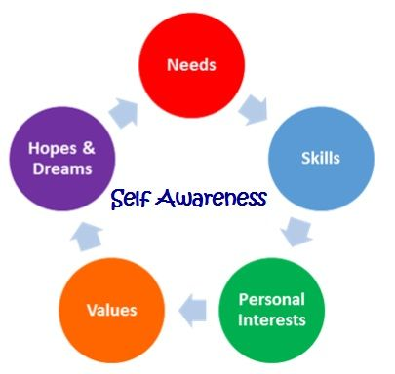

Slide 9
Thanks

