Slide 1

SADBHAVNA COLLEGE OF EDUCATION FOR WOMEN, JALALDIWAL
Subject: Understanding the self
Topic: Self Acceptance
Incharge: Ms.Manpreet Kaur

Slide 2

Concept of Self Acceptance

Slide 3

self acceptance is the “ degree to which an individual , having considered his personal characteristics, and willing to live with them”.

Slide 4
Characteristics of Self acceptance
Assurance about standards and convictions
Recognise their shortcomings
Realistic appraisal of his resources
Self Acceptance gives courge to live life with truth

Slide 5
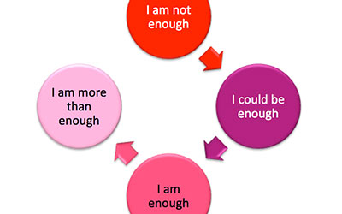
The Self acceptance Path

Slide 6
Conditions leads to Self Acceptance
Self Understanding
Realistic Expectations
Absence of Environmental obstacles
Favorable social Attitudes
Absence of Emotional stress
Identification with well adjusted people
Good Childhood Training

Slide 7
Thanks

