Slide 1

SADBHAVNA COLLEGE OF
EDUCATION FOR
WOMEN, JALALDIWAL
Subject: Understanding the self
Topic: Schooling in national identity development
Incharge: Ms.Manpreet kaur

Slide 2
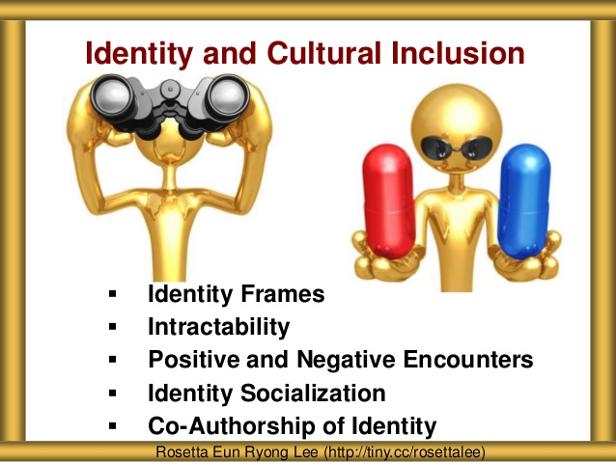

INTRODUCTION
Meaning of National Identity
National identity is one’s identity or sense of belonging to one state or to one nation. It is the sense of a nation as a cohesive whole, as represented by distinctive traditions, culture, language and politics.

Slide 3

CHARACTERISTICS OF NATIONAL IDENTITY
SELF-CATEGORIZATION : National identity requires the process of self- categorization and it involves both the identification of in- group (identification with one’s nation),and differentiation of out-groups(other nations).

Slide 4

National identity as a collective phenomenon:
National identity can be thought as a collective product. Through socialization, system of beliefs, values, assumptions and expectations is transmitted to group members.

Slide 5

National identity is a social phenomenon:
National identity, like other social identities, engenders positive emotions such as pride and love to one’s nation, and feeling of obligations toward other citizens.

Slide 6

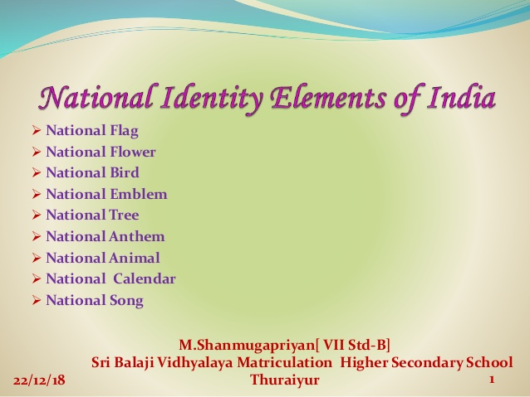
National identity elements:
National flag, national bird, national flower, national ID No.(Aadhaar card is unique ID card of every indian citizen).

Slide 7

SCHOOL AND ITS ROLE IN DEVELOPING NATIONAL IDENTITY
Feeling of patriotism
Ethnic tolerance learned
Education provides the identity
Co-curricular Activities

Slide 8
CONCLUSION
THE TRANSACTION BETWEEN STUDENT AND SCHOOL IS THUS CONCEPTUALIZED IN TERM OF THE STUDENT’S SCHOOL EXPERIENCE(COMPOSED OF VARIOUS ASPECT: THE SCHOOL SELF- IMAGE, THE SCHOOL STRAEGIES, AND THE INTEGRATION IN THE PEER GROUP)

Slide 9
THANKS

