Slide 1
SADBHAVNA COLLEGE OF EDUCATION FOR WOMEN, JALALDIWAL
Subject: Understanding the self
Topic: Schooling as a process of identity formation
Incharge: Ms.Manpreet Kaur raikot

Slide 2
INTRODUCTION
Meaning of School:
Etymologically, the word school has been derived from the greek word `Skohle’ which means leisure. In ancient greece, leisure places were used for the development of the personality of the individuals.

Slide 3
SCHOOL IN THE SELF DEVELOPMENT

Slide 4
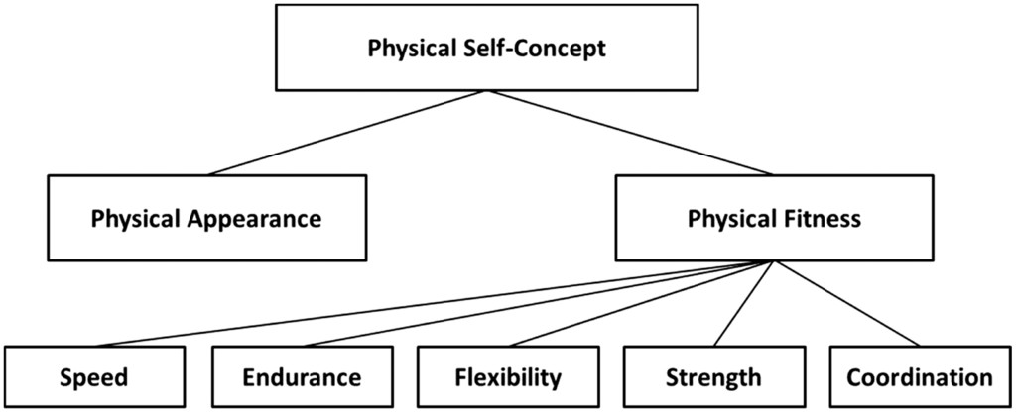
Development of physical self

Slide 5
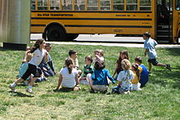
Socialization of the individual:

Slide 6
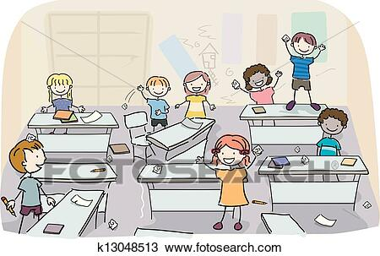
Modification of the Behaviour:

Slide 7
Cultivation of dynamic and adaptable mind:

Slide 8
Influence of Teacher:

Slide 9
CONCLUSION
The above views makes it clear that the school is places which conserves, promotes and transmits culture , prepare children for citizenship, intellectual, moral and social needs of the students.

Slide 10
THANKS

