Slide 1

SADBHAVNA COLLEGE OF EDUCATION FOR WOMEN, JALALDIWAL
Subject: Understanding the self
Topic: School and secular identity
Incharge: Ms.Manpreet kaur Raikot

Slide 2

INTRODUCTION
Meaning of secularism
The realization of fatherhood of god and the brotherhood of mankind is called secularism.

Slide 3

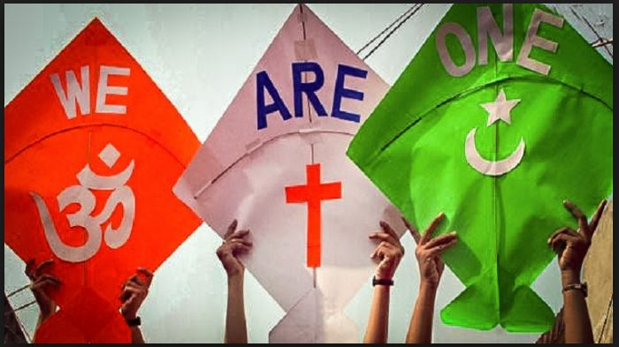

Slide 4
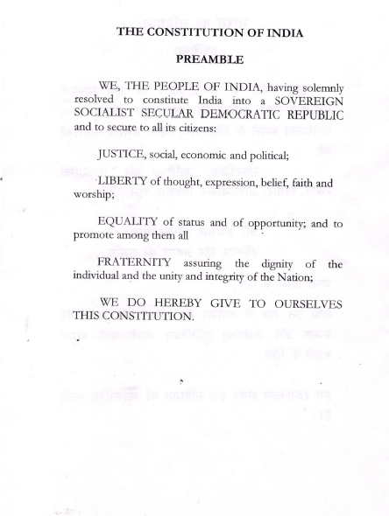

Slide 5
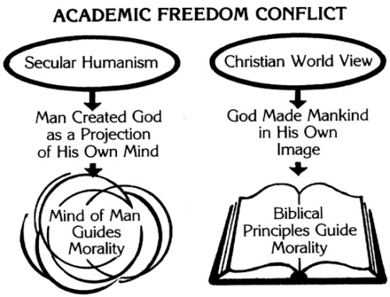
SCHOOLING IN THE DEVELOPMENT OF SECULAR IDENTITY
SECULARISM IN EDUCATION: Secularism in education means making public education free from any religious dominance, especially in its learning environment.

Slide 6
NEED OF SECULAR EDUCATION IN SCHOOL
Indian is a multi religious and culturally varied society.
To train the youth to be good citizens.
To inculcate in the youth social, moral and cultural values.
To strengthen secularism and human relationship in india.
To fulfill the requirements of democratic india.

Slide 7
CHARACTERISTICS OF SECULAR EDUCATION
Secular Aims
Multiple curricula
Science teaching
Enlightened teachers
Cultural and moral outlook
Development of wider vision
Democratic values
Humanitarianism

Slide 8
CONCLUSION
In secular india, the citizen should recognize
The religious pluralisms of this country and have an objective attitude towards religions. Education should promote such ideals. This will enhance the cohesiveness and brotherhood among the people in a plural development society like india.

Slide 9
THANKS

