Slide 1

SADBHAVNA COLLEGE OF EDUCATION FOR WOMEN, JALALDIWAL
Subject: Understanding the self
Topic: Role of individual self in development of society.
Incharge: Ms. Manpreet Kaur

Slide 2
INTRODUCTION
Man is a social animal. It is well know that society consist of individuals. Individuals influence the society. Man needs society for his existence or survival. The human child depends on his parents and others for its survival and growth.

Slide 3


Slide 4
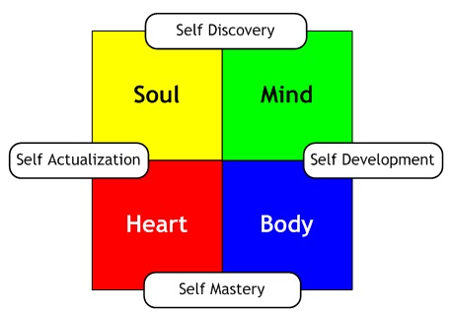
DEVELOPMENT OF SELF
LANGUAGE
PLAY
GAMES

Slide 5

NEED OF SOCIALIZATION IN SELF DEVELOPMENT
Family and home
Family is the conves of tradition
Social control family
Socical economic status the fanul
School
a)Behaviour
b)Intelligence self
c)Development of citizenship

Slide 6

Need of SOCIALIZATION

Slide 7

SELF IN THE DEVELOPMENT OF SOCIETY
Society importance
Etiquetee
Discipline
Spirituality
Moral

Slide 8
CONCLUSION
We still call it our society, but in real we don’t live in society. We prefer to live in small surroundings which we created from our own. It just consists of only family members for the safety and for warmth. So self especially the social self makes ones to understand the society.

Slide 9
Thanking you

