Slide 1

SADBHAVNA COLLEGE OF EDUCATION FOR WOMEN, JALALDIWAL
Subject: Understanding the self
Topic: Factors Affecting Self-Identity(culture, Religion, & Language)
Incharge: Ms. Manpreet Kaur

Slide 2
“CULTURE IS THAT COMPLEX WHICH INCLUDES ITEMS, BELIEFS, TRADITIONS, CUSTOMS AND ANY OTHER CAPACITY AND HABITS ACQUIRED BY MAN AS A MEMBER OF SOCIETY”
CULTURE AND SELF-IDENTITY

Slide 3
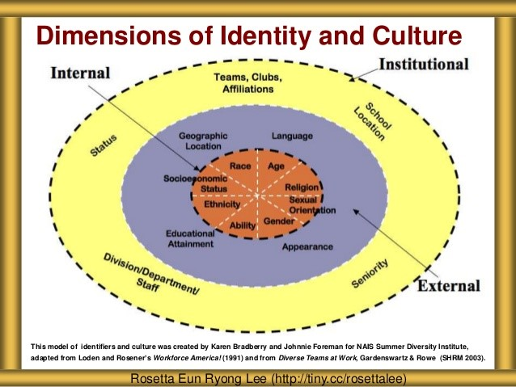

Slide 4
Factors affecting self-identity: CULTURE
Culture is social heritage and not a biological one.
It is something organic.
It changes as the society changes and the civilization changes. Every generation adds to it.
It is idealistic. It stands for ideal norms of human behaviour.
it has dynamic quality.

Slide 5
Factor involve in language identity
Language is such a power concept because it has the ability to completely shape one’s personal identity . The usage of words and phrases significantly impacts individuals’ thoughts and character/personal identity. Language is an extremely powerful tool that aids in building new relationships and experiences.
Information development
Self knowledge

Slide 6
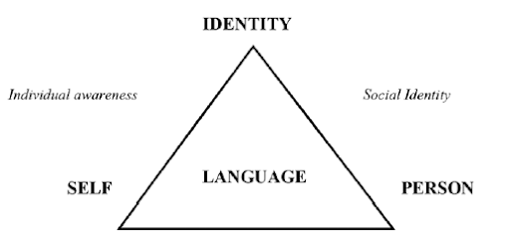

Slide 7
Factors involve in Religious Identity
Gender differences affect religious identity
Ethnic differences
Community and religious identity
Institutional factors
Self concept

Slide 8
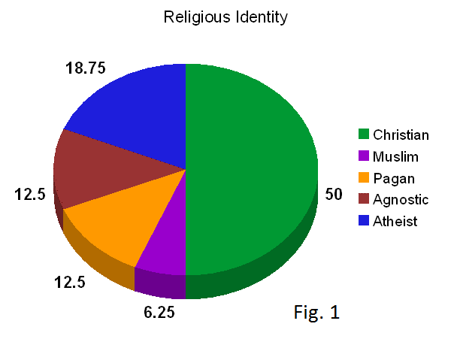


Slide 9
CONCLUSION
Culture, Religion, language has such a greater influence on an individual’s life contributing majorly to the self- concept of an individual. The influence might either be negative or positive depending on the type of factor that one has been brought up in.

Slide 10
Thanking You

