Slide 1

SADBHAVNA COLLEGE OF
EDUCATION FOR
WOMEN, JALALDIWAL
Subject: Understanding the self
Topic: Concept of Self
Incharge: Ms. Manpreet Kaur

Slide 2
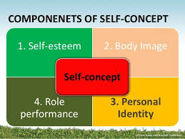
CONCEPT OF SELF
Self or Emperical Me is the sum total of all that a man can call his –his body, traits, and abilities, his material possessions: his family, friends and enemies: his vocations and avocations and much else.

Slide 3
Constituents of Self
Material Self
Social Self
Spiritual self
Pure ego

Slide 4

Constituents of Self
Material Self:
Consists of his material
Possessions.

Slide 5

Social Self: consists how he is regarded by his fellows

Slide 6
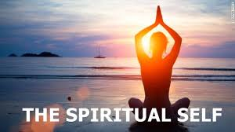
Spiritual self: Consists of his psychological faculties and dispositions

Slide 7
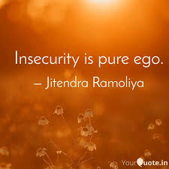
Pure ego: The stream of thoughts which constitutes one’s sense of personal identity

Slide 8
Thanks

