Slide 1

SADBHAVNA COLLEGE OF EDUCATION FOR WOMEN, JALALDIWAL
Subject: Understanding the self
Topic: Factors Affecting Self-Identity(family, gender)
Incharge: Ms. Manpreet Kaur

Slide 2



Slide 3
INTRODUCTION
Relatively stable, Role – specific understandings and expectations about self, who am I? what make me special? Why am I here? Every child asks and answers these questions.
Identity refers to the ways in which individuals and collectivities are distinguished in their social relations with other individuals and collectivities.

Slide 4
Same idea, different words
Self and aggregates (Buddhist psychology)
Self and id, ego, and super-ego( Freudian psychoanalysis)
Self and parts (internal family systems model or IFS)
Self and complexes & archetypes (Analytical psychology)
Self and sub personalities (psycho synthesis)

Slide 5
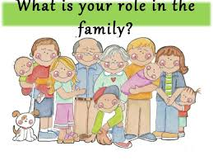
FACTORS AFFECTING SELF- IDENTITY(FAMILY, GENDER)
FAMILY
Happy marriage, happy children
Developing identity through mimicking behaviour
Parents and identity in Adolescence
Self-confidence
Family Identity
Political Identity
Occupational Identity
Establish Our core Identity

Slide 6
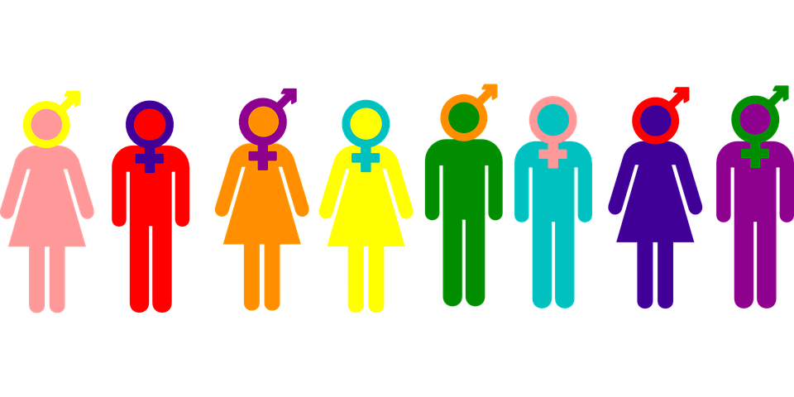
Gender as a factor in identity formation
Self categorization
Biological and genetic make up
Stereotypes

Slide 7
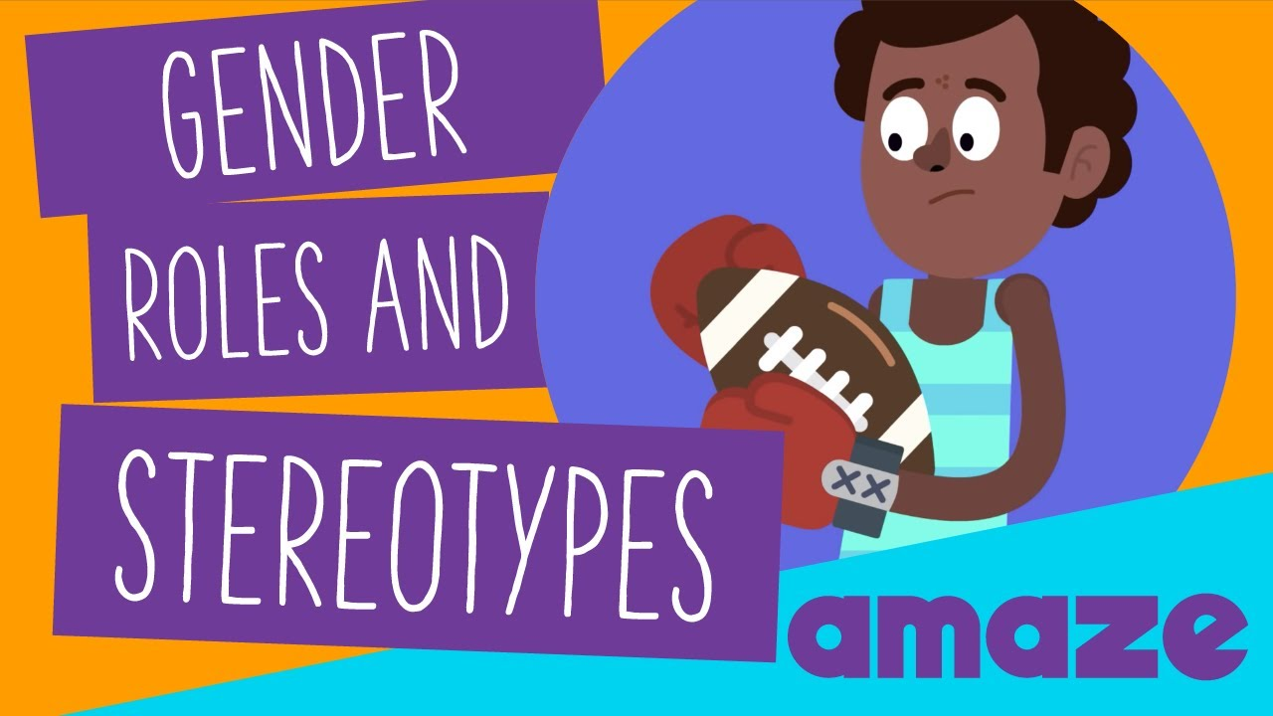

Slide 8
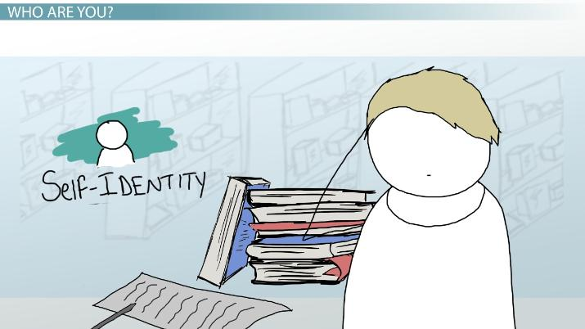
CONCLUSION
Various conditions of family environment lead to significant differences in the levels of children’s identity development during adolescence and young adulthood.

Slide 9
Thanks

