Slide 1

SADBHAVNA COLLEGE OF EDUCATION FOR WOMEN, JALALDIWAL
Subject : School library services
Topic: The school library problems
Incharge: Ms.Manpreet kaur Raikot

Slide 2

Introduction
In india libraries appeared in school due to variety of reasons. In the early times the educational system was of the gurukula type where the student was expected to live with the teacher.

Slide 3

LIBRARIES PROBLEMS
Lack of Extension service
Problem in book Acquisition
Financial Problem
Lack of Computerization
Lack of Library Central Philosophy
Technological problem
Lack of proper services

Slide 4
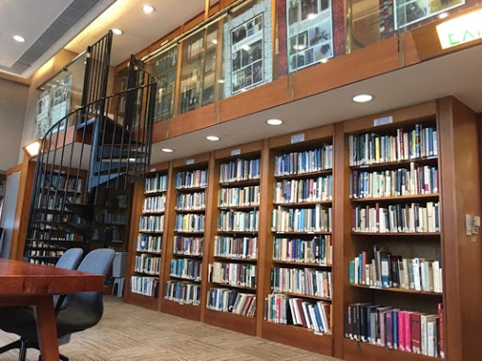
Lack extension service:
But in most of the school libraries, there is luck at extension service. The time schedule of students is very busy.

Slide 5

Problems in Book acquisition:
Major publishers in India are more centered in metro cities such as Delhi, Mumbai and for a library situation in remote area takes a lot of time span to acquire latest publication without delay.

Slide 6
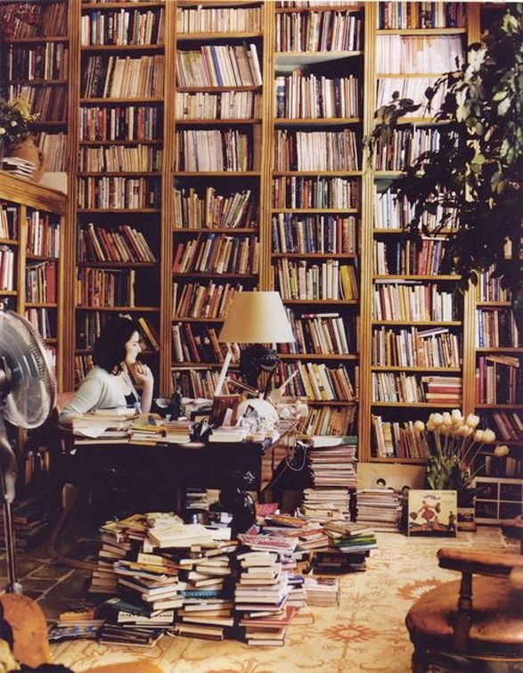
FINANCIAL PROBLEM:
In present time the libraries are facing the actual problem of finance.

Slide 7

Lack of computerization:
Today is the age of digital era. Many foreign contraries are using software to digitalize the library.

Slide 8

Manpower problems:
In school there is no qualified library staff. In school the librarian is not given the status and pay scale.

Slide 9
CONCLUSION
IN MANY SCHOOL THE CONDITIONS OF SCHOOL LIBRARIES IS VERY BAD. THE GOVERNMENT SHOULD HAVE GIVES GRANTS THE NEW BOOKS.

Slide 10
THANKS

