Slide 1

SADBHAVNA COLLEGE OF EDUCATION FOR WOMEN, JALALDIWAL
Subject : School library services
Topic: Library rules and regulation
Incharge: Ms.Manpreet kaur Raikot

Slide 2

Introduction
Rules plays vital role for the proper functioning of school library. Different libraries formulate their own rules and regulation.

Slide 3
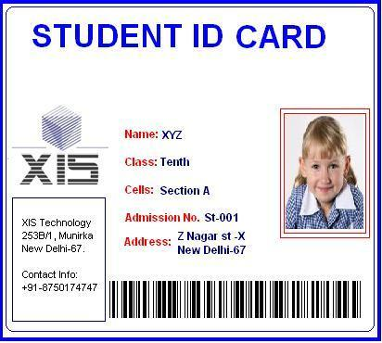
Library rules and regulation
Library hours: During regular class days
7:30am -7:00pm Monday to Friday
8:00am- 12:00pm –Saturday
Identification cards: Only students with identification card will be granted library privileges ID? IS required at all times.

Slide 4
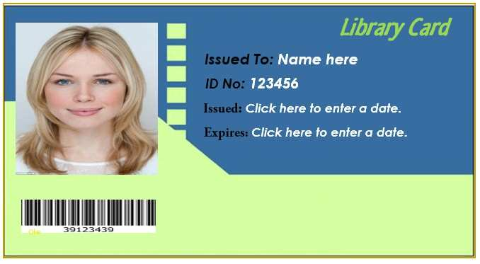
:Library Cards
Only those students with library cards will be allowed to borrow books. They should apply for a new library card if it is lost.

Slide 5

FINES:
These books may be borrowed for one week, renewable for a demand and should be returned after a week. A fine days including Saturdays, sundays and holidays

Slide 6

Vertical file materials:
This is a collection of clippings, pamphlets and other non-books for reference.

Slide 7
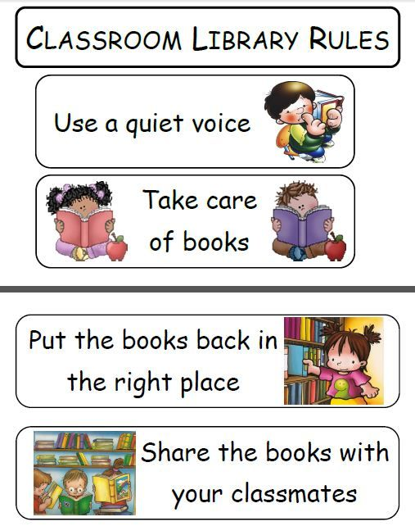

General conduct:
Silence should be observed at all times.
Eating or smoking inside the library is absolutely pohibited.
Books and other materials may not be taken out from permission from the librarian.

Slide 8
CONCLUSION
So, users have been made aware of the library as a primary source of information, then must be oriented to library facilities, each members are familiar with these rules so as to get best possible services from the library .

Slide 9
THANKS

