Slide 1

SADBHAVNA COLLEGE OF EDUCATION FOR WOMEN, JALALDIWAL
Subject : School library services
Topic: Importance of School library
Incharge: Ms.Manpreet kaur Raikot

Slide 2
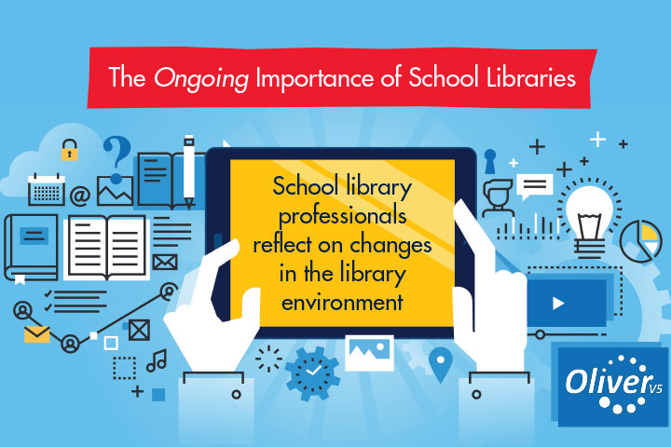


Slide 3
INRODUCTION
Libraries provide another space for children to learn. They can help students navigate the internet, offer a quiet area for students to study, and encourage students to read.

Slide 4

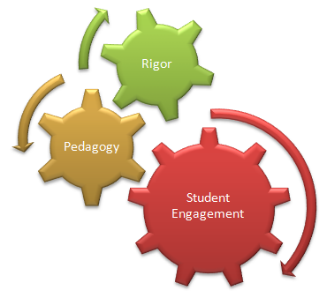
Improves student out comes:
Collections development for your unique school community enrich reading and learning programmes.
:

Slide 5


Welcomes people in:
The library is a safe place, that values and includes students from different cultures and backgrounds bring people and information together.

Slide 6
Bring people and information together
Embodies the principles of ‘learner agency’
Helps close the education gap
Improve reading test scores
Higher academic achievement
Positive attitudes towards learning.

Slide 7
CONCLUSION
Public libraries provide free access to information, technology and out-of-school hours. Because of their universal presence in communities and providers of information, libraries may play a special role in web of support communities provide for youth.

Slide 8
THANKS

