Slide 1

SADBHAVNA COLLEGE OF EDUCATION FOR WOMEN, JALALDIWAL
Subject: School Library Services
Topic : Five laws of library science and their implications.
Incharge: Ms. Manpreet kaur Raikot

Slide 2
INTRODUCTION
The law of library science were evolved by Dr. Ranganathan. These are also called as fundamentals law. These are five in number. By the term ‘law’ we means body of rules and guidelines.
1st law: books are for use.
2nd law: Every reader his/her book.
3rd law: Every book its reader
4th law: Save the time of the reader
5th law: library is a growing organisation

Slide 3
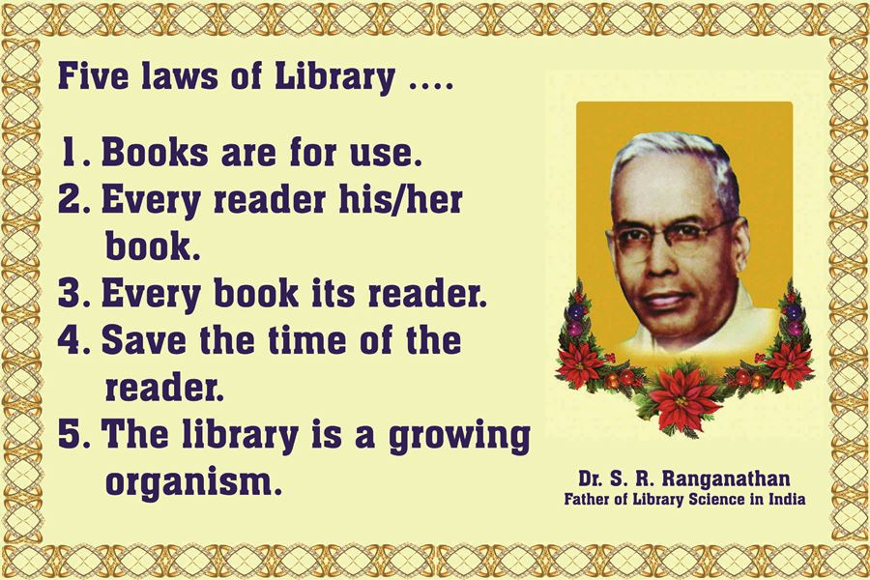

Slide 4

1st law: Books Are For Use
In those days, libraries were regarded as organization for preservation, but not for furthering their use.
Library location
Book selection
Library hours
Maintenance
Library staff

Slide 5
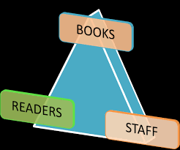
2nd law: every reader his/her book
The 1st law replace the concept of ‘book are for preservation’ similarly, the 2nd law advocates for the users.
Open access system
Selection of books
Qualified staff
Obligation of the reader
Inter library loan

Slide 6

3rd law: Every book its reader
It means every book read by the readers. It means that every book in a library must have its reader.
Open Access
Shelf Arrangements
Catalogues
Reference services
Accessibility

Slide 7

4th law: save the time of the reader
This law demands saving the time of the reader as well as staff. Save the time of the staff is regard as a co-realate to this law.
Open access v/s closed access
Shelf Arrangements
Information technology
Library guide

Slide 8
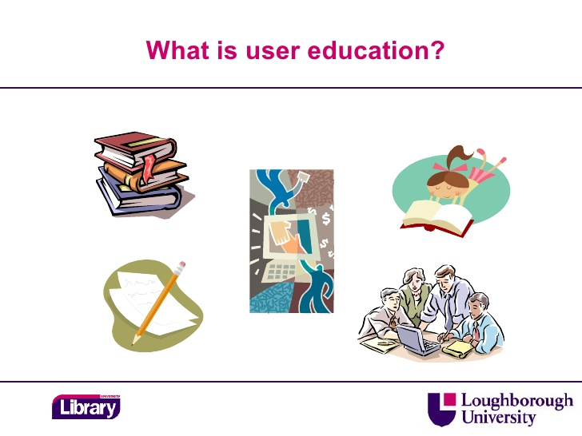
5th law :library is a growing organisation
According to fifth law : “ a library is growing organism.” a library is a social institution.
Choice of classification scheme
Physical form of a catalogue
Reference services
User education

Slide 9

CONCLUSION
These are fundamentals law of library science. These also provide guidance in the practice of library and information science. The laws have been useful in the teaching of different branches of library science.

Slide 10
THANKS

