Slide 1
Sadbhavna College of education for women raikot, jalaldiwal ludhiana

Slide 2
Subject
Reading
and Reflecting

Slide 3
Topic – Techniques of Multilingualism
Incharge- Sunita
Rani

Slide 4
Status of Indian Language Classroom
Knowledge of Language
Learning Mother Tongue
Study of English
Language of Administration
Physical Mental Development
Knowledge Culture
International Understanding
Increasing National Unity
Equality

Slide 5
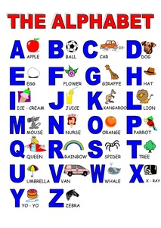
Techniques of Multilingualism
Basic Alphabet
Knowledge
Grammar Learning

Slide 6
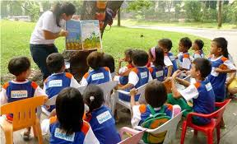
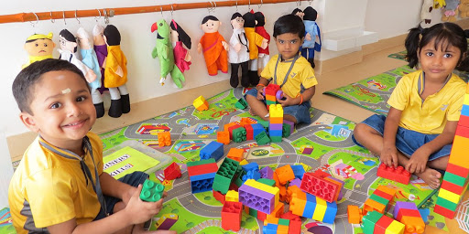
Story Telling
Method
Play Way
Method

Slide 7
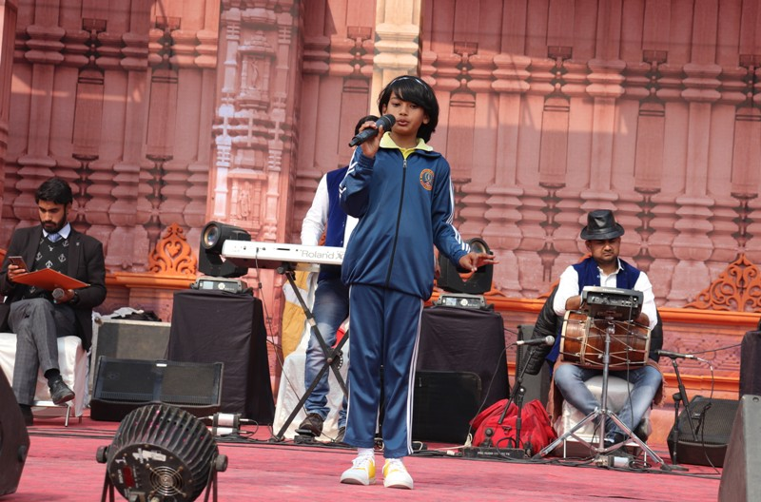
Through Various
Competitions
Language
Films

Slide 8
THANKS

