Slide 1
SADBHAVNA COLLEGE OF EDUCATION FOR WOMEN RAIKOT, JALALDIWAL LUDHIANA

Slide 2
SUBJECT
READING
AND
REFLECTING

Slide 3
TOPIC
Stages of Learning
to Read
Incharge - Sunita Rani

Slide 4
Stages of Learning to Read
Knowledge of
Picture and Language
Practice

Slide 5
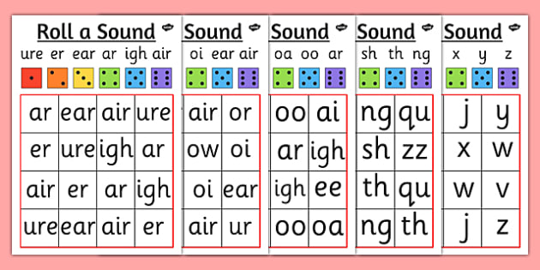
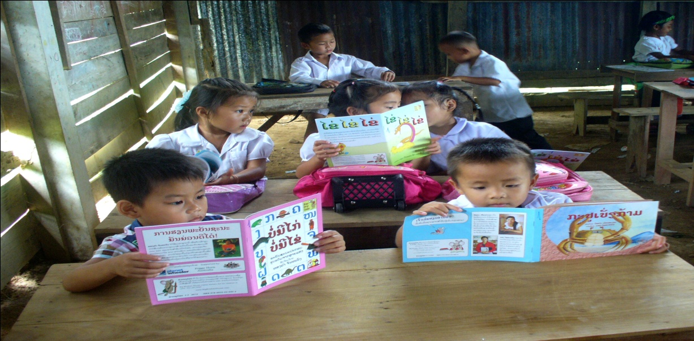
Sound Difference
Script Difference

Slide 6
THANKS

