Slide 1
SADBHAVNA
COLLEGE
OF
EDUCATION
FOR
WOMEN
RAIKOT
JALALDIWAL
LUDHIANA

Slide 2
SUBJECT
READING
AND REFLECTING

Slide 3
TOPIC
Speaking Skill
Incharge – Sunita
Rani

Slide 4
Meaning
Language is a tool for communication. We communicate with others, to express our ideas and to know others ideas as well. In primary schools, elocution and recitation are the main sources to master the sounds, rhythms and intonations of the language through simple production of poems and articles. Team work activities are sources to learn to speak a language.

Slide 5
Importance of Speaking
Beginning life of Children
from Oral Language
Importance in the old time
Importance in the daily
routine
Importance in the
communicating with others

Slide 6
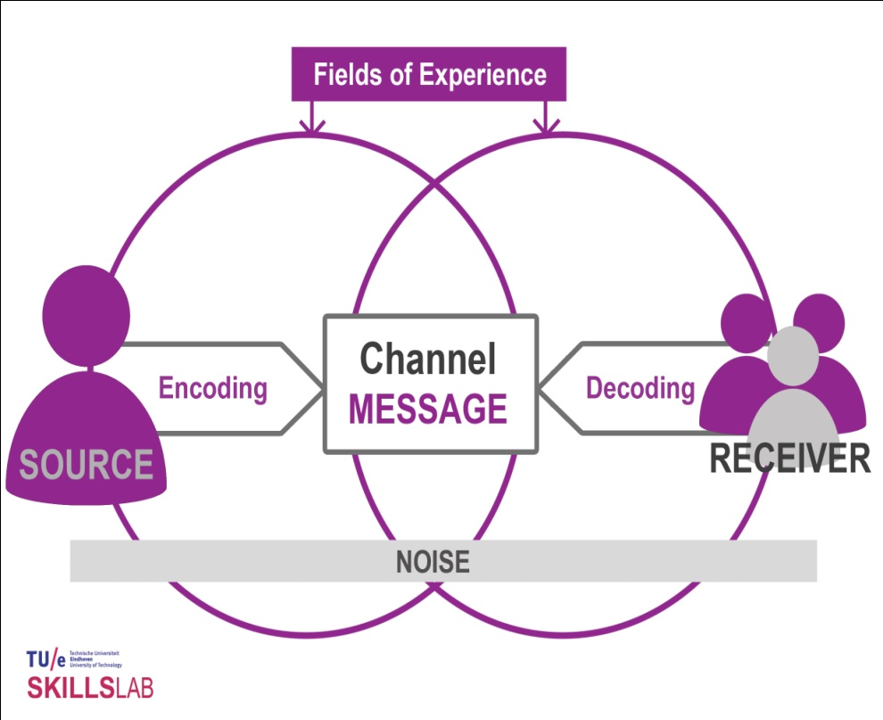
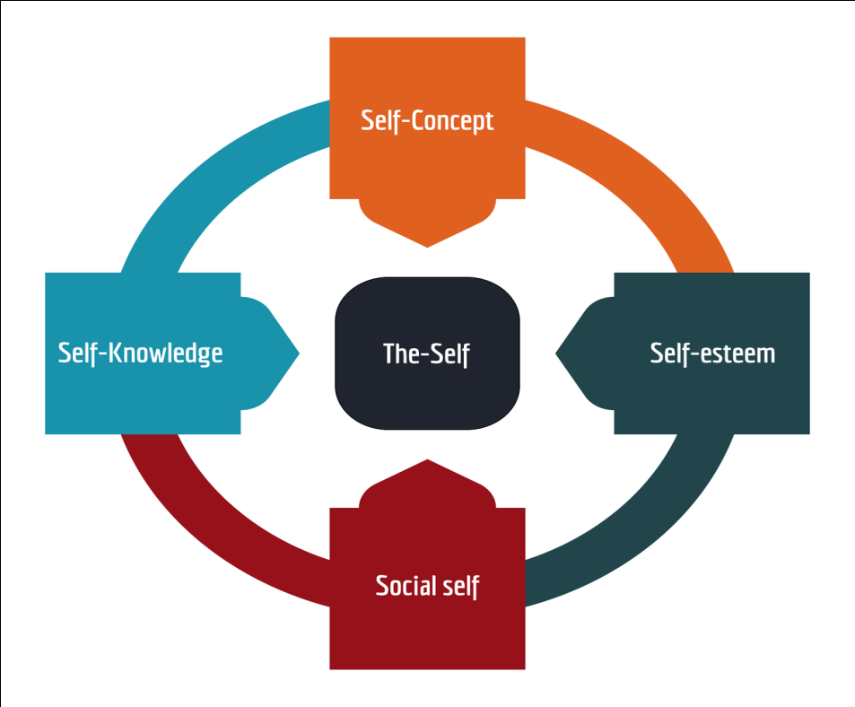
Good source of
communication
Help in self
presentation

Slide 7
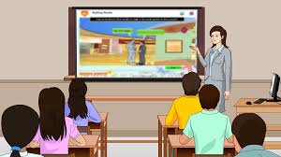
For balanced
psychological
development of
child
Importance in
language
Teaching

Slide 8
Importance in
writing
language
Importance
in Education
of other
subjects

Slide 9
Importance
for a teacher
Importance in professional area

Slide 10
Importance in constructing Human personality
Oral language easy to understand

Slide 11
THANKS

