Slide 1
Sadbhavna College of Education for women Raikot, Jalaldiwal Ludhiana

Slide 2
Subject
Reading
and
Reflecting

Slide 3
Topic
Role of School
Language in
Classroom
Instructions
Incharge - Sunita Rani

Slide 4
Role of School Language in Classroom Instructions Mutual or Oral Conversation

Slide 5
Discussion

Slide 6
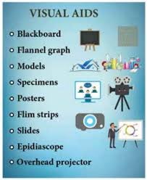
Use of Audio- Visual Instruments

Slide 7
THANKS

