Slide 1
Sadbhavna College of Education for women Raikot, Jalaldiwal Ludhiana

Slide 2
Subject
Reading
and
Reflecting

Slide 3
Topic
Role of Language
in Classroom
Incharge - Sunita
Rani

Slide 4
Easy and Universal Education
Role of Language in Classroom

Slide 5
Helps in Chid’s
Primary Education

Slide 6
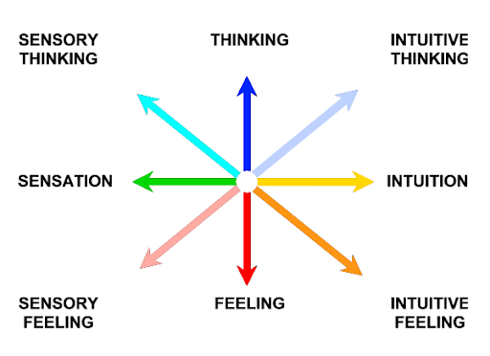
Psychological Functions Jung’s Theory of Psychological types

Slide 7
Social Functions

Slide 8
Historical Information

Slide 9
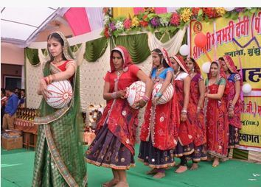
Cultural Functions

Slide 10
Right and Proper Education

Slide 11
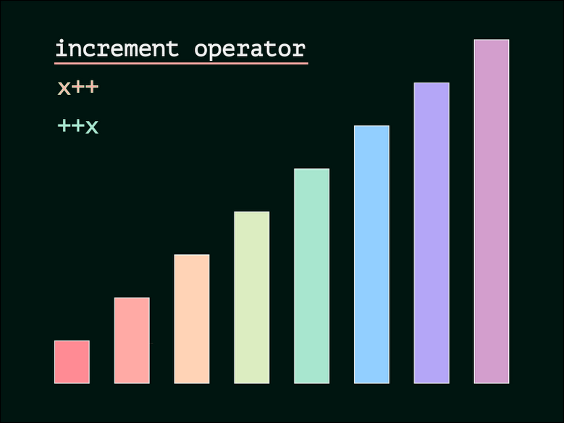
Increment of Understanding

Slide 12
Increment of Speaking Skill

Slide 13
Helps in Communication between School and Society

Slide 14
THANKS

