Slide 1
SADBHAVNA COLLEGE OF EDUCATION FOR WOMEN
RAIKOT , JALALDIWAL, LUDHIANA

Slide 2
SUBJECT
READING
AND REFLECTING

Slide 3
TOPIC –ROLE OF HOME AND SCHOOL LANGUAGE
INCHARGE –
SUNITA RANI

Slide 4
Home Language vs School Language
There is no problem for the children who have the same language both in the home environment and in the class room situations. In fact, the language spoken at home gets boost up at school.

Slide 5
PROCESS OF LEARNING HOME LANGUAGE
Learning of home language takes place in a very natural way. From the birth of a child he is surrounded by an atmosphere where mother tongue is spoken.

Slide 6
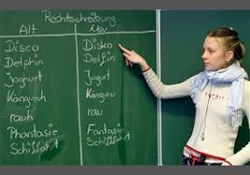
PROCESS OF LEARNING SCHOOL LANGUAGE
The process of learning school language or the second language is the same because listening and speaking precede reading and writing.

Slide 7
Role of Home Language
Enrollment made easy
Participation of Parents
Development of better thinking skills
Provides greater opportunities
Better understanding instructions
Development of Vocabulary
Improves academic performance
Helpful in learning second language
Improved learning outcomes during school
Expand the reach of education

Slide 8
THANKS

