Slide 1
SADBHAVNA COLLEGE OF EDUCATION FOR WOMEN RAIKOT, JALALDIWAL LUDHIANA

Slide 2
SUBJECT
READING
AND
REFLECTING

Slide 3
TOPIC
Motivation to Read
Incharge–Sunita Rani

Slide 4
Motivation to Read
Relax Classroom
Atmosphere
Reward

Slide 5
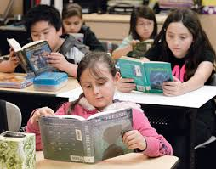
Silent Reading

Slide 6
Reading Room
Literature Books
Reading

Slide 7
Encouragement
Key questions

Slide 8
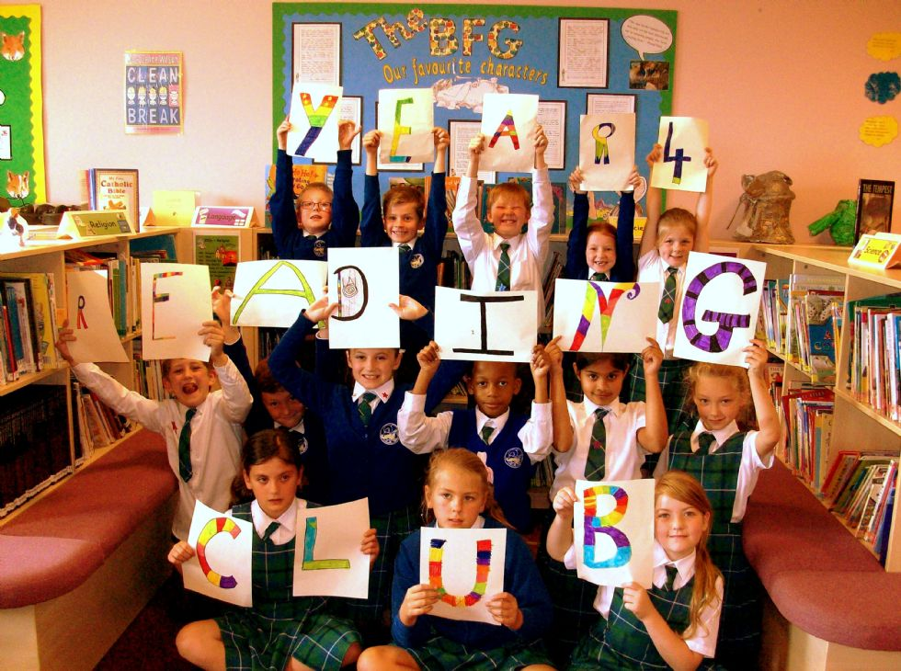
Aloud Reading
Reading Club

Slide 9
THANKS

