Slide 1
SADBHAVNA COLLEGE OF EDUCATION FOR WOMEN
RAIKOT , JALALDIWAL, LUDHIANA

Slide 2
READING AND REFLECTING
UNIT - 1

Slide 3
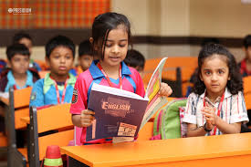
READING

Slide 4
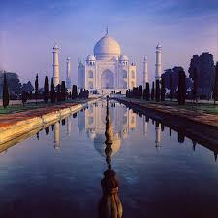
REFLECTING

Slide 5
Meaning of Language
The question ‘What is Language?’ comparable with ‘What is life?’ Everyone knows what life is but one cannot present a satisfactory definition of life. The same is the case with language. The term ‘language’ can be understood better in terms of its characteristics. Language is, in fact too complex a phenomenon to be bound by a single definition. Here are some of the definitions.

Slide 6
DEFINITIONS
“Language is a system of arbitrary vocal symbols used for human communication.”- Wardaugh
“Language is a set of sentences, each finite in length and constructed out of a finite set of elements.”
- Chomsky
“Language is a system of arbitrary vocal symbols by means of which a social group co-operates.”
- Bloch and Trager

Slide 7
ROLE OF LANGUAGE
No Existence of Society without Language
No Language without Society
Requirement of both for all round development
Development of Civilization

Slide 8
Thanks

