Slide 1
SADBHAVNA COLLEGE OF EDUCATION FOR WOMEN
RAIKOT , JALALDIWAL, LUDHIANA

Slide 2
SUBJECT
READING
AND
REFLECTING

Slide 3
TOPIC
Linguistic Skill
Listening

Slide 4
LISTENING
Meaning- Listening is a
receptive language skill
which learners usually
find the most difficult.
The listener need to be
attentive. Listening skills
could be enhanced by
focusing on making the
students listen to the
sounds of that particular language.

Slide 5
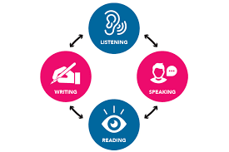
Characteristics of Listening
Helpful in development
of other language skill
Helpful in attaining
language Teaching
objectives

Slide 6
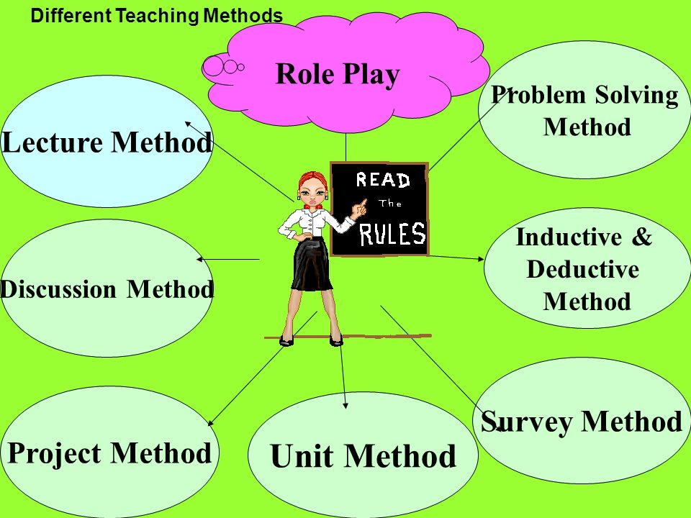
Helpful in learning
other subjects
Proper use of
teaching methods
Importance of
Communication

Slide 7
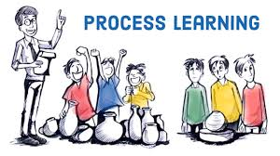
First stage of Acquiring
Helpful in learning
process
Importance in daily routine
Helpful in development innovative ideas
For Success in
debate competitions

Slide 8
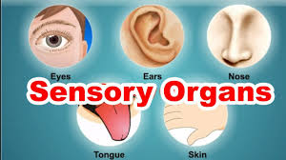
Importance of Knowledge of
proper language
Helpful in pure oral pronunciation
Helpful in form of teaching
For proper use of sensory
organs
For attaining new
knowledge
For development
proper writing skills

Slide 9
THANKS

