Slide 1
SADBHAVNA COLLEGE OF EDUCATION FOR WOMEN
RAIKOT, JALALDIWAL
LUDHIANA

Slide 2
READING
AND
REFLECTING

Slide 3
TOPIC
Importance of Reading
Incharge - Sunita Rani

Slide 4
Importance of Reading
Helpful in Developing Personality

Slide 5
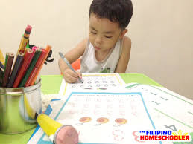
Helpful in Developing Writing Skill
Special Importance
in Correspondence
Education

Slide 6
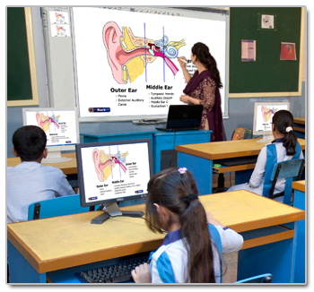
Essential for Modern
Importance in
Educational
Field

Slide 7
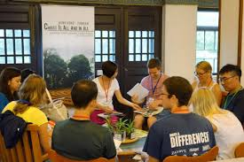
Importance in Common Life
Importance Source of Attaining Knowledge
Good Source of Recreation
Helpful in Becoming Good Citizens

Slide 8
Helpful in Developing
Speaking Skill
Social Utility

Slide 9
THANKS

