Slide 1
SADBHAVNA COLLEGE OF EDUCATION FOR WOMEN RAIKOT, JALALDIWAL LUDHIANA

Slide 2
SUBJECT
READING
AND
REFLECTING

Slide 3
TOPIC
Questioning as
tool of Language
Learning
Incharge - Sunita Rani

Slide 4
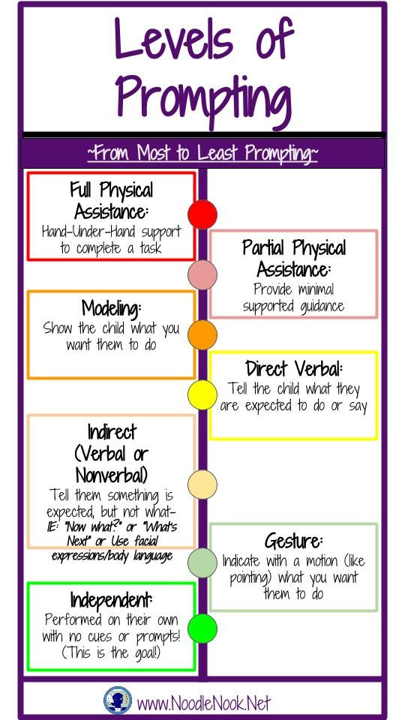
Components of Questioning
Prompting
Example:
Teacher : John, what is the square root of 94?
John : I don’t know
Teacher: Well, what is the square root of 100?
John : Ten
Teacher : And the square root of 81?
John : Nine

Slide 5
Refocusing
Redirection

Slide 6
Seeking Further
Information
Increasing
Critical
Awareness

Slide 7
THANKS

