Slide 1
SADBHAVNA COLLEGE OF EDUCATION FOR WOMEN RAIKOT,JALALDIWAL
LUDHIANA

Slide 2
SUBJECT
READING
AND REFLECTING

Slide 3
TOPIC
Characteristics of
Reading
Incharge – Sunita Rani

Slide 4
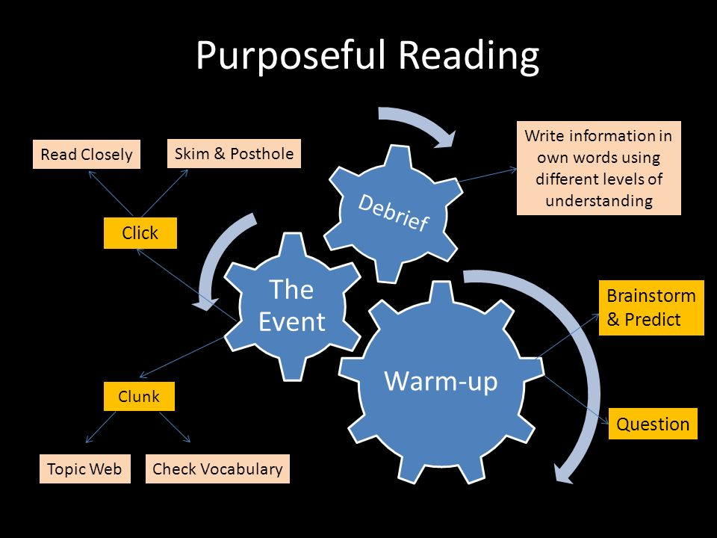
Characteristics of Reading
Reading is
purposeful
Reading is
Selective

Slide 5
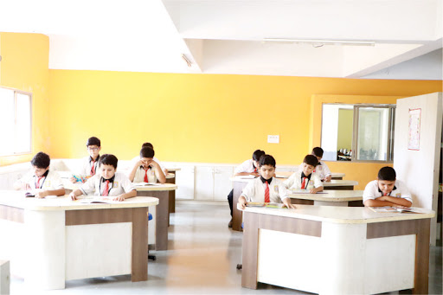
Reading speed
varies individual
to individual
Silent Reading

Slide 6
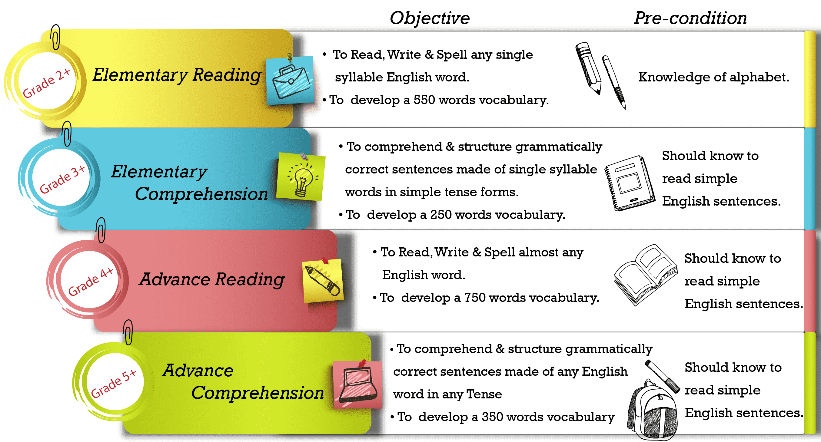
Reading is Meaningful
Reading is Objective

Slide 7
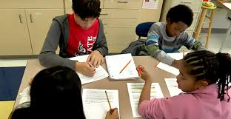
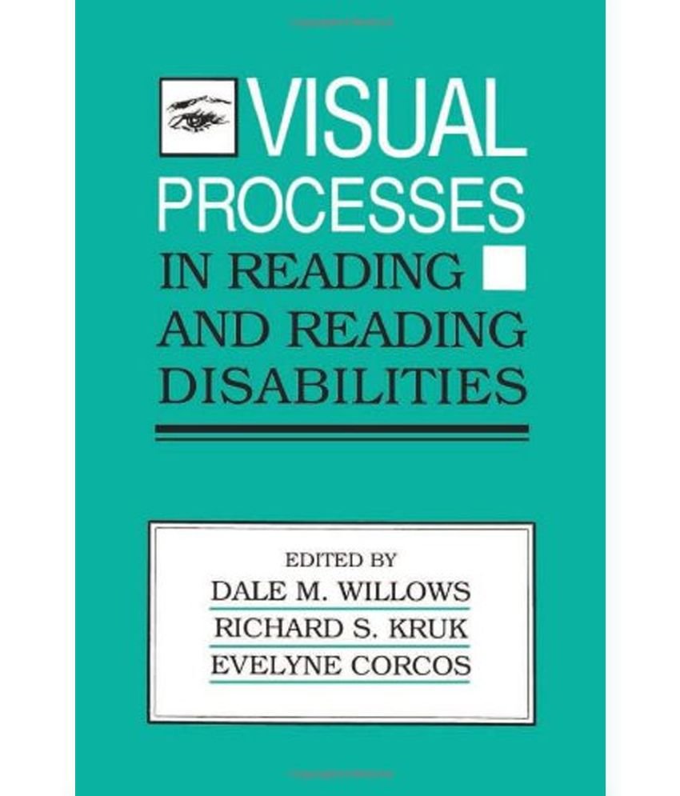
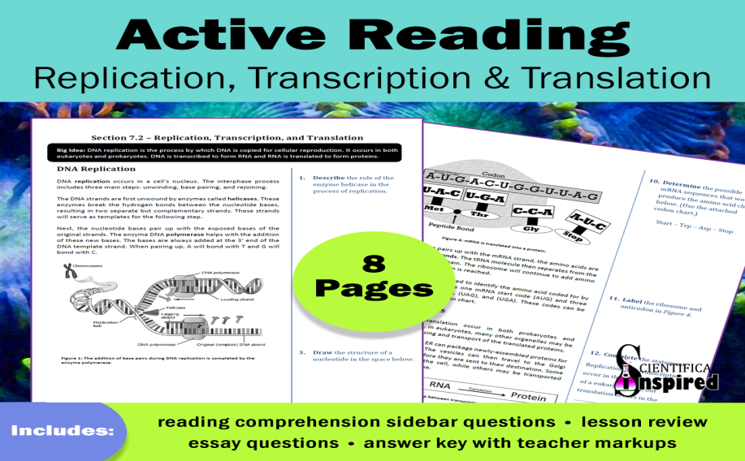
Reading is an intricate process
Reading is a two way process
a) Visual process b) Active process

Slide 8
THANKS

