Slide 1
SUBJECT- GENDER, SCHOOL AND SOCIETY
TOPIC – NEED AND IMPORTANCE OF GENDER EQUALITY
Asst. Prof. MANPREET KAUR
SADBHAVNA COLLEGE OF EDUCATION FOR WOMEN, RAIKOT

Slide 2
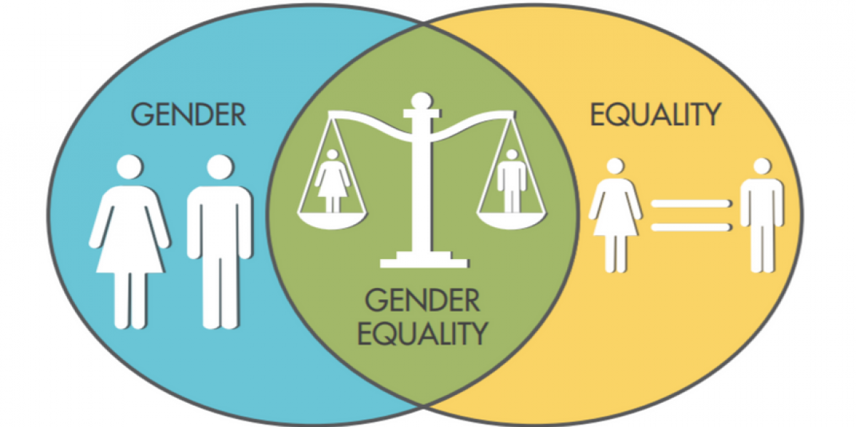

Slide 3
NEED AND IMPORTANCE OF GENDER EQUALITY
AS A HUMAN RIGHT
EQUAL DISTRIBUTION OF RESOURCES
EQUALITY BREAKS STEREOTYPE
UNIFORMITY IN EVERYTHING
NO NEED BASED
DISCARD INDIVIDUAL DIFFERENCES
ACCESS TO SAME OPPORTUNITIES
FAIRNESS
SOCIAL CHANGE
OBJECTIVITY
IT REDUCES POVERTY
ECONOMIC GROWTH

Slide 4
THANK YOU

