Slide 1
SUBJECT- GENDER SCHOOL AND SOCIETY
TOPIC – CAUSES OF GENDER BIAS
In-charge:
Asst. Prof. MANPREET KAUR
SADBHAVNA COLLEGE OF EDUCATION FOR WOMEN, RAIKOT

Slide 2
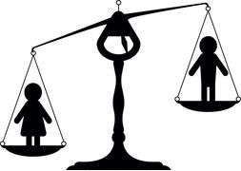
GENDER BIAS

Slide 3
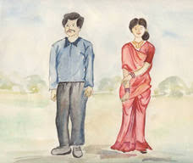
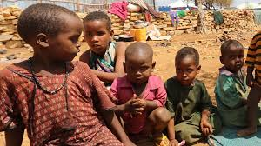
CAUSES OF GENDER BIAS
1. SOCIAL CUSTOMS, BELIEFS AND PRACTICES
2. POVERTY

Slide 4
4. LACK OF EMPLOYMENT FACILITIES
3. CULTURAL DISCRIMINATION

Slide 5
6. DEPENDENCE ON MEN
5. LACK OF EDUCATION

Slide 6
7. SOCIAL ALTITUDE
8. LACK OF AWARENESS IN WOMEN

Slide 7
9. NARROW MINDSET
10. STEREOTYPICAL THINKING

Slide 8
THANK YOU

