Slide 1
B.ED (SEM-III)
SUBJECT- GENDER, SCHOOL AND SOCIETY
TOPIC- CAUSES OF GIRLS DROPPING OUT FROM SCHOOL
Asst. Prof. MANPREET KAUR SADBHAVNA COLLEGE OF EDUCATION FOR WOMEN, RAIKOT

Slide 2
CAUSES OF GIRLS DROPPING OUT FROM SCHOOL
1. FAMILY RESPONSIBILITIES
2. EARLY MARRIAGE
3. INADEQUATE FACILITIES
4. SHORTAGE OF FEMALE
TEACHERS
5. DISCRIMINATION
6. RURAL SCHOOLS

Slide 3
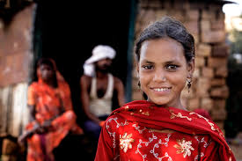
7. LOW ASPIRATION RELATED TO GIRLS EDUCATION
8. POVERTY
9. LOCATION OF SCHOOL
10. HEALTH
11. FEELING UNMOTIVATED
12. LACK OF GUIDANCE
13. PERSONAL FAMILY ISSUES

Slide 4
THANK YOU

