Slide 1
B.ED (SEM-III)
SUBJECT- GENDER, SCHOOL AND SOCIETY
TOPIC – SCHOOLING OF GIRLS
(INEQUALITIES AND RESISTANCE)
Asst. Prof. MANPREET KAUR SADBHAVNA COLLEGE OF EDUCATION FOR WOMEN, RAIKOT

Slide 2
INTRODUCTION
Gender inequality in India refers to health, education, economic and political inequalities between men and women in India. Various international gender inequality indices rank India differently on each of these factors,
as well as on a composite basis
and these indices are controversial.
The female child in India is often
deprived from her right of the education.
The number of girls dropping out of school far exceeds the boys because girls are expected to help at home, either with household work like washing and cooking or with taking care of younger siblings. The gap between male and female equality in rural parts of India that education is no help to the girl and her primary job will be to look after the household work, get married early, have children and then raise them.

Slide 3
NEED AND IMPORTANCE OF GIRLS EDUCATION
1. INCREASE INVOLMENT IN POLITICAL PROCESS – Educated women are more likely to participate in political discussions, meetings and decision-making, which in turn promotes a more representative, effective government.
2. DECREASE SUPPORT FOR MILITANCY – As women become more educated, they are less likely to support militancy and terrorism that similarly educated men.
3. IMPROVE SOCIO-ECONOMIC GROWTH – Educated women have a greater chance of escaping poverty, leading healthier and more productive lives and raising the standard of living for their children, families and communities.

Slide 4
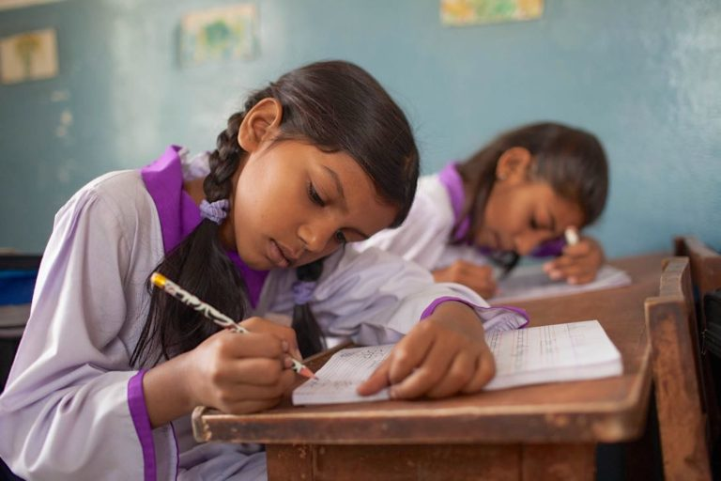
4. DECREASE MATERNAL MORALITY – Educated women with greater knowledge of health care and fewer pregnancies are less likely to die during pregnancy.
5. DECREASE CHILD MARRIAGE – Child marriage
almost always results in the end
of a girl’s schooling. The results is
illiterate or barely literate young
mothers without adequate tools to
build healthy educated families.
6. DECREASE POPULATION EXPLOSION – Educated women tend to have fewer babies.

Slide 5
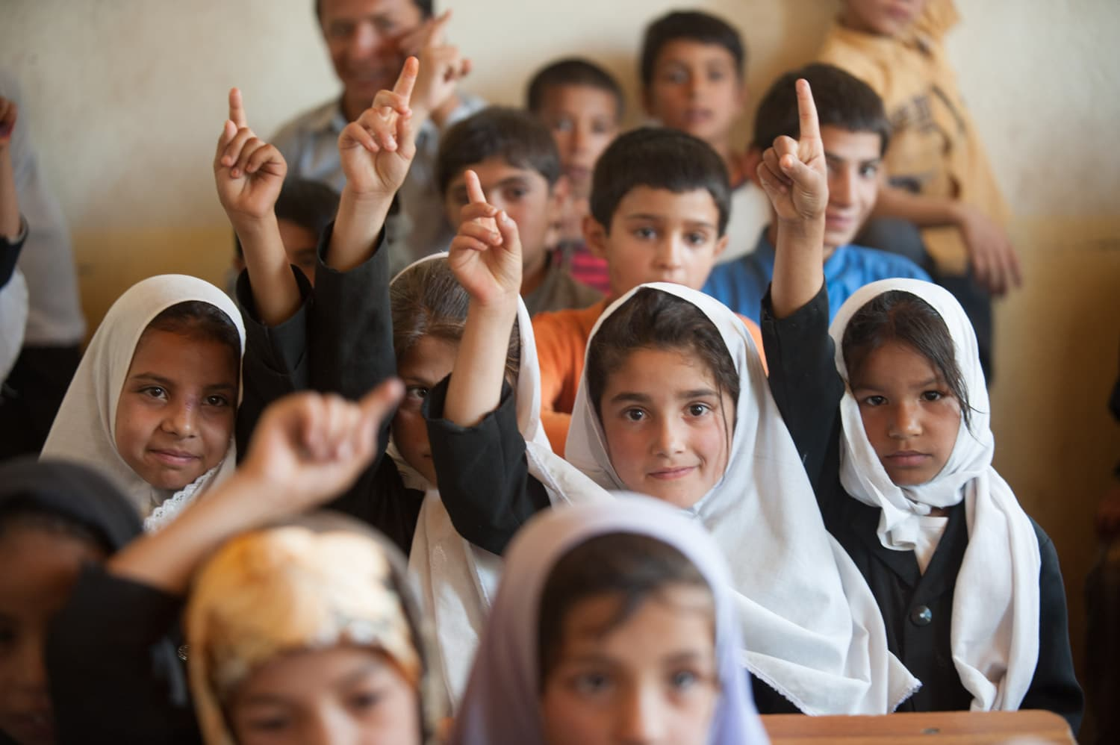
7. EDUCATED FUTURE GENERATIONS – By sending a girl to school, she is far more likely to ensure that her children also receive an education.
8. DECREASE INFANT MORALITY – Children of educated women are less likely to die before their first birthday. Primary education alone helps reduce infant morality significantly and secondary education helps even more.

Slide 6
THANK YOU

