Slide 1
B.ED (SEM-III)
SUBJECT- GENDER, SCHOOL AND SOCIETY
TOPIC - ELIMINATING GENDER BIAS IN EDUCATION
Asst. Prof. MANPREET KAUR SADBHAVNA COLLEGE OF EDUCATION FOR WOMEN, RAIKOT

Slide 2
CHANGE IN MIND SET
We still presuppose that it is mother who should bear final responsibility for home and childcare. Women are expected to work, but men are not expected to assume responsibility for the home and childcare. It is the time for both men and women to have equal and interchangeable roles at home and at work.

Slide 3
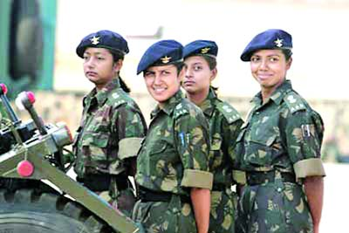
WOMEN IN TOP POSITION
Encourage the girls to enter the field that enable a person to reach top positions. Increased academic achievements of and employment opportunities for middle class women have little to improve the position of working class and other socially marginalized women.

Slide 4
CHANGE IN CURRICULUM
Curriculum should enable every girl and every boy to try fields. Science and technology be made less male oriented. Technology and economics can be made compulsory, physical education to be taught in mixed groups.

Slide 5
BIAS FREE EDUCATIONAL MATERIAL
Government can lead campaign and take initiative to eradicate gender bias from curriculum, educational materials, textbooks and school practices through equality programmes in schools. The textbook writers and those engaged in production of teaching learning materials must be sensitized on gender concerns in education.

Slide 6
AWARENESS OF EDUCATORS
Educators need to be made aware of the bias they are reinforcing in their students through socialization messages, inequitable divisions of special education services, gender biased texts and materials and unbalanced time and types of attention spent on boys and girls in the classroom.

Slide 7
NO MORE DIVISION
School hierarchy be divided more equally between men and women. Let the girls and boys sit in the classroom alternately on the same bench. Not divide the children into groups on sex for learning activities. Let them also play games of all sorts in mixed groups in the schools.

Slide 8
THANK YOU

