Slide 1
SUBJECT- GENDER, SCHOOL AND SOCIETY TOPIC – GENDER BIAS IN TEXTBOOKS Asst. Prof. MANPREET KAUR SADBHAVNA COLLEGE OF EDUCATION FOR WOMEN, RAIKOT
B.ED (SEM-III)

Slide 2
Gender Bias in Textbooks
1. SUBJECT MATTER
* FEMININE - Home Science,
Cookery, Typing, Biology, Nursing.
* MASCULINE - Physics, Chemistry,
Mathematics, Woodwork.
2. THEMATIC CONTENT
* Invisible women
* Unequal or inadequate representation of women.
* More importance to men or boys.

Slide 3
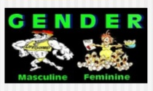
3. GENDER STEREOTYPES
Role Stereotypes
Character Stereotyping
Polarization of male and female characteristics.

Slide 4
THANK YOU

