Slide 1
B.ED (SEM-III)
SUBJECT- GENDER, SCHOOL AND SOCIETY
TOPIC – MERITS AND DEMERITS OF PATRIARCHY
Asst. Prof. MANPREET KAUR SADBHAVNA COLLEGE OF EDUCATION FOR WOMEN, RAIKOT

Slide 2
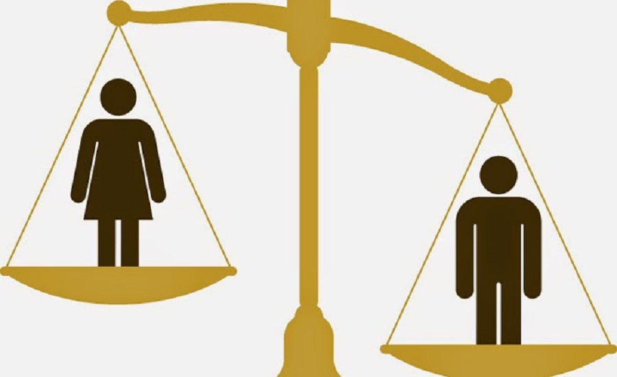
patriarchy

Slide 3
MERITS OF PATRIARCHY
The leader of the family is already decided, So there is no dispute or question.
In this system, no more burden of leadership or responsibility given to women so that they can focus their primary responsibilities of nurturing children
Many women feel valued for their unique contribution patriarchal system.
It gives a structure to the society and a place and role for everyone.
A male is only head who gives direction to the family members and encourage them to serve others.

Slide 4
DEMERITS OF PATRIARCHY
In patriarchy system, women are completely neglected and their path of development is blocked.
Women are not provided equal status of men.
This system is completely disregard the rile of women.
Women becomes victims of exploitation and harassment.
Women’s are not involved in the decision making.

Slide 5
Thank you

