Slide 1
B.ED (SEM-III)
SUBJECT- GENDER, SCHOOL AND SOCIETY
TOPIC – PATRIARCHY
Asst. Prof. MANPREET KAUR SADBHAVNA COLLEGE OF EDUCATION FOR WOMEN, RAIKOT

Slide 2
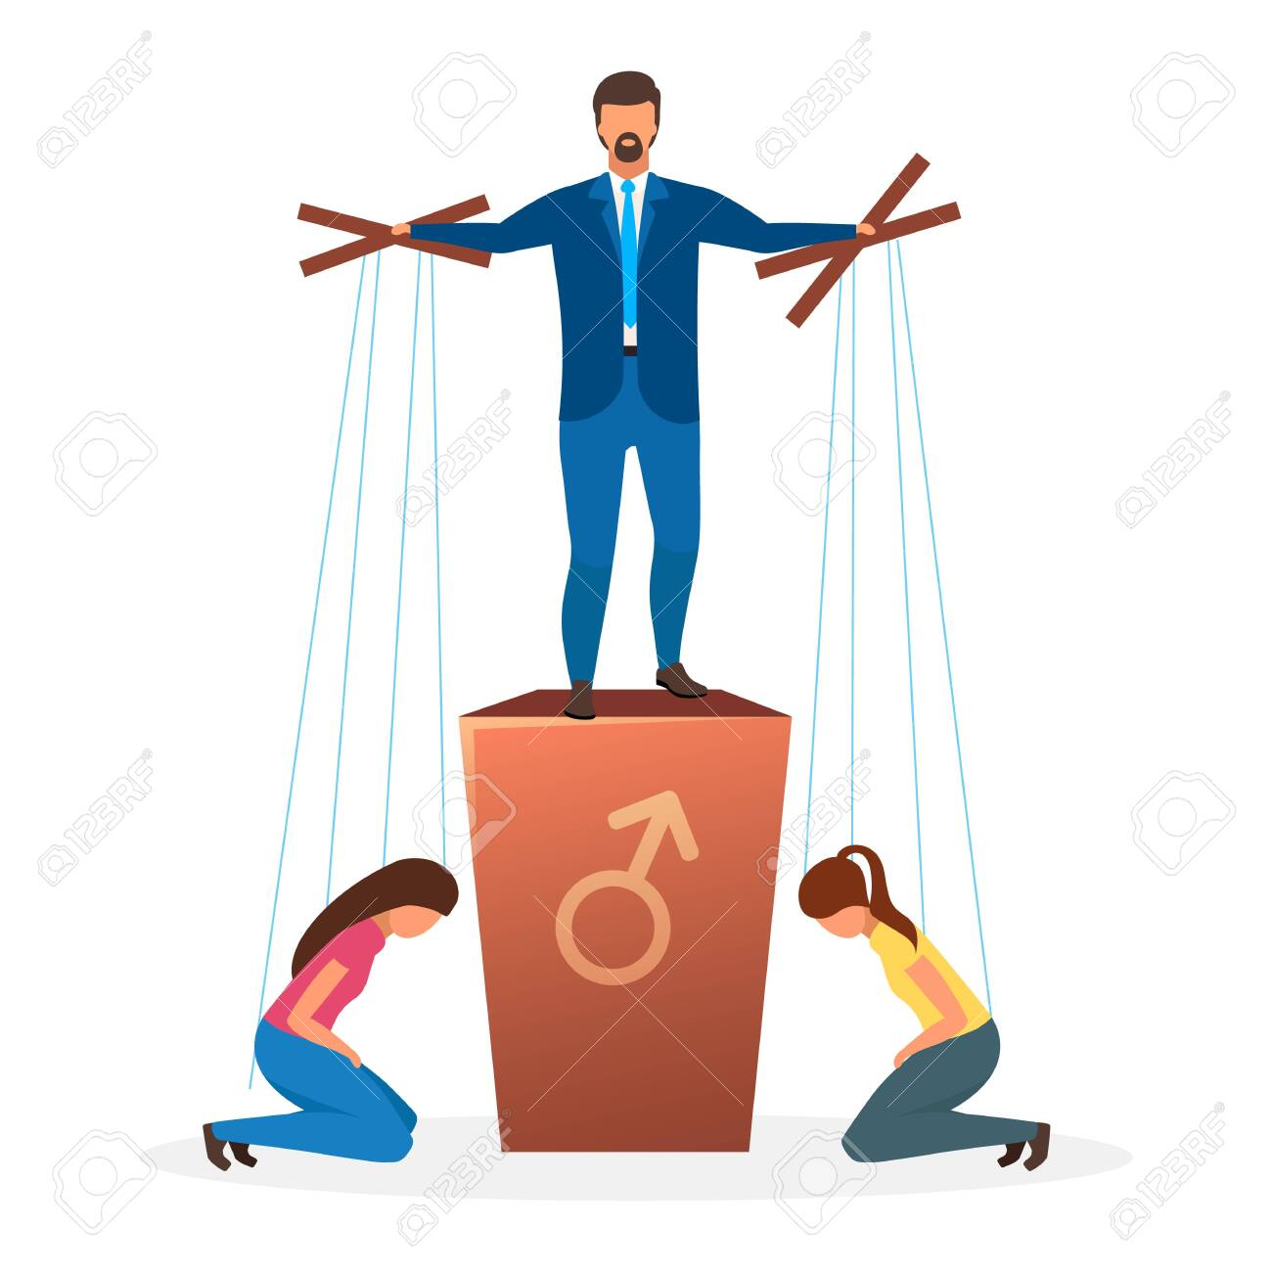
PATRIARCHY

Slide 3
MEANING
Patriarchy is a system of society in which the oldest male is the leader or head of family. In patriarchy all rights, powers and property is transferred from father to son. Females are considered subordinate and accessory. A society that gives more social, political and economic power to men is called Patriarchy. Patriarchy is common around the world and throughout the society. It includes any social, political or mechanism that evokes male dominance over women.

Slide 4
DEFINITIONS
THERBORN - Paternal power is the core meaning of patriarchy, historically and etymologically. Powerful fathers are also husbands, so it seems both logical and practical to extend the notion of patriarchy to the power of husbands.
NAPIKOSKI - Patriarchal describes a general structure in which men have power over women. Society is the entirety of relations of a community. A patriarchal society consists of a male-dominated power structure throughout organized society and in individual relationships.

Slide 5
THANK YOU

