Slide 1
SADBHAVNA COLLEGE OF EDUCATION FOR WOMEN RAIKOT , JALALDIWAL, LUDHIANA
MICRO TEACHING
TOPIC

Slide 2
PROCEDURE OF SIMULATED

Slide 3
Some Expert Views
Bush’s – “Micro teaching is a teacher education technique which allow teachers to apply well defined teaching skills to a carefully planned lesson in a planned series of five to ten minutes, encounters with a small group of real classroom students, often with opportunity to observe the performance on video-tape.”
Allen & Ryan’s – “Micro teaching ia a system of controlled practice that makes it possible to concentrate on specific behavioure and to practice teaching under controlled conditions.”

Slide 7
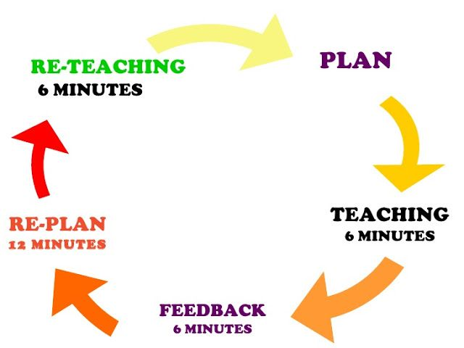

Slide 8
THANKS

