Slide 1
PEDAGOGY OF SOCIOLOGY ASST.PROF:BALJINDER KAUR

Slide 3
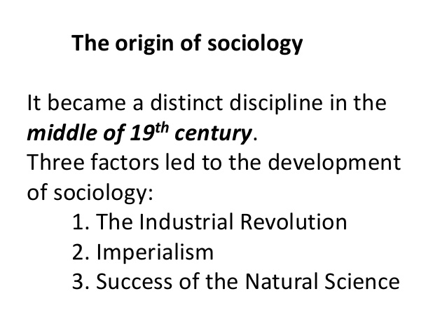

Slide 5
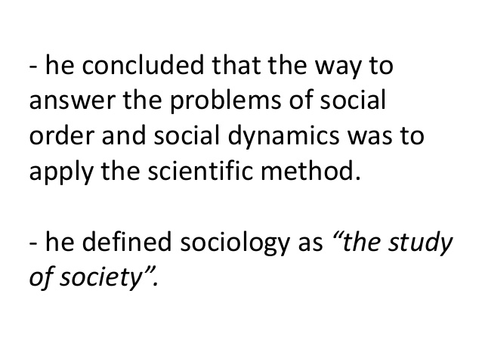

Slide 10
THANK YOU

