Slide 1
PEDAGOGY OF SOCIOLOGY ASST.PROF:BALJINDER KAUR

Slide 20
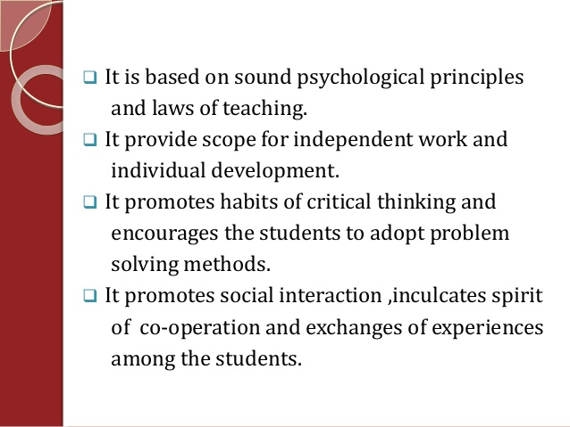

Slide 26
THANKS

