Slide 1
PEDAGOGY OF SOCIAL STUDIES
ASST. PROF: BALJINDER KAUR

Slide 9
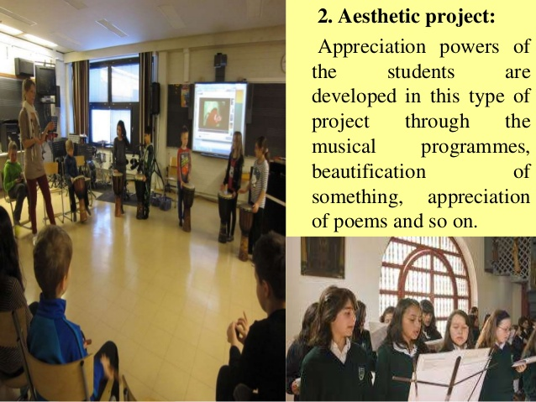

Slide 22
THANKS

