Slide 1
MAGER’S APPROACH
UNIT 1 PART 3
Pedagogy of science and life science
HARINDER KAUR
Asst.Professor
Sadbhavna College Of Education

Slide 2
Formulation of specific objectives in behavioral terms
Behavioral objectives may be defined as a “specific,concrete,delimited objective in a particular situation and under specific circumstances, in relation to a particular broad objectives”
They are also known as performance based objectives.
NCERT refers to them as expected learning outcomes.

Slide 3
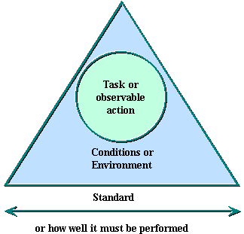
Elements of an Objective

Slide 4
Characteristics of Objectives
“Objective is a subject in which you are familiar with and will be able to identify correctly”
Performance – Competency Level
Conditions – Under what conditions do you
want the learner to be able to do?
Criteria – How well must it be done?

Slide 5
Objectives by Mager
  Performance is what the learner
  will be able to do
  Condition is under what conditions the learner will be able to do it
  Criterion is how well it must be done

Slide 6

Performance Objectives Are :

Slide 7
Example of behavioral objectives topic : flower and its parts
At the end of the lesson an average pupil will be able to:
1Explain at least 2 functions out of 4 of different parts of a flower when shown a specimen of the flower.(knowledge)
2 Differentiate at least between 2 parts out of 4 between different parts of the flower.(Knowledge)
3 Dissect and draw at least 2 parts out of 4parts of the flower when shown a chart (skill)

Slide 8
Advantages of Robert Mager’s approach
Identify the terminal behavior by name.
Define the desired behavior.
Specify the desired criteria of acceptable performance.
He focused his attention on cognitive and affective domain.

Slide 9
Limitations
No emphasis on mental processes.
Neglecting psychomotor domain.
Not suitable for higher level objectives.
Overlapping of action verbs in cognitive and affective domain.

