Slide 1
charts

Slide 7
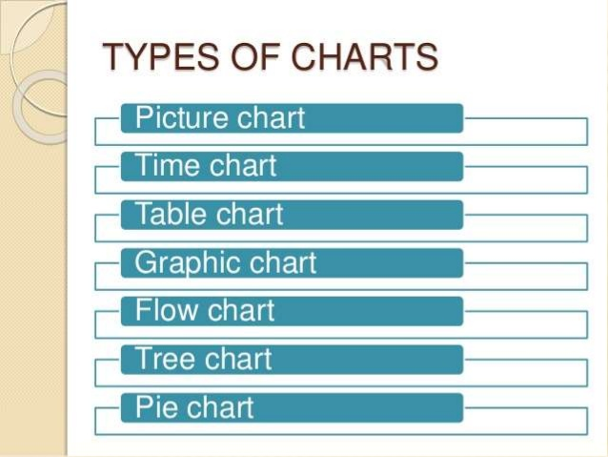

Slide 8
Charts
It must be simple and should convey clear thoughts.
Well organized with artistic principles
It should be neat, well labeled.
It should not be overcrowded.
Colors may be used to distinguish different parts.

Slide 9
Models
Model is representation of an idea , event, process, system or image of any real object.
It is a miniature reproduction of the object.
Model playa a crucial role in science teaching.
It provides an environment for interactive engagement.
It can enhance systematic thinking abilities.
They leave a long lasting impression on the minds of the students.

Slide 11
Animations
It is a method in which pictures are manipulated to appear as moving images.
They are made with computer generated imagery.
They are 2-d vector based or 3D based animations,

Slide 12
Animations
It is a cognitive as well as an affective tool as it attracts attention.
It helps to portray activities that are interactive, creative, fun and motivational.
It enhances imagination and rational thinking.
They facilitate positive peer interaction.
Encourages self motivation to create and solve problems.

