Slide 1
Scientific attitude pedagogy of science and lifescience
Harinder kaur
Asst. professor
Sadbhavna college of Education

Slide 2
Scientific attitude
Definition: Scientific attitude can be defined as, “open mindedness, a desire for accurate knowledge, confidence in procedures for seeking knowledge and the expectation that the solution of the problem will come through the use of verified knowledge”.

Slide 3
characteristics of scientific attitude
A man with scientific attitude has :
i. is critical in observation and thought,
ii. respects other’s point of views and is ready to change his decision on presentation of new and convincing evidence,
iii. is curious to know more about the things around him wants to know whys, what’s and how’s of things he observes,
iv. does not believe in superstitions and false beliefs ,
v. suspends judgments until suitable support is obtained,
vi. believes in cause and effect relationship,
vii. accepts no conclusions as final or ultimate,
viii. seeks to adopt various techniques and procedures to solve the problem and
ix. seeks the facts and avoids exaggeration.

Slide 4
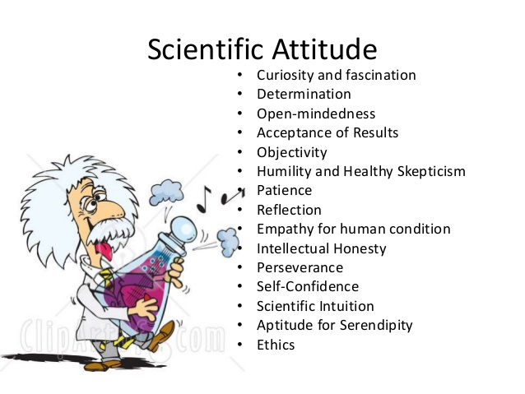

Slide 5
Dimensions of scientific attitude
rationality,
open mindedness,
curiosity,
aversion to superstition,
objectivity of intellectual beliefs
suspended judgment

Slide 6
Techniques of developing scientific attitude
Study of superstitions and analysis of wrong beliefs
Planning exercises
Make use of scientific literature
Effective use of laboratory period
Inclusion of co-curricular activities in science programme.
Developing appropriate classroom atmosphere.
Using personal examples.

