Slide 1
SADBHAVNA COLLEGE OF EDUCATION FOR WOMEN RAIKOT , JALALDIWAL, LUDHIANA
TOPIC
Laboratory Method
Asst. Prof – Sunita Rani

Slide 5
Parts of Laboratory
Planning
Work
Summarization
Evaluation

Slide 8
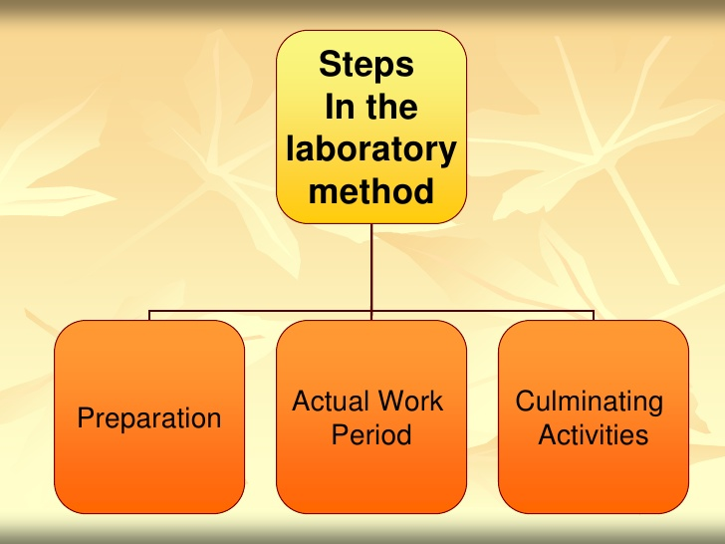
Basic Opinion of Attainment Model

Slide 11
Procedure:
Aims of the practical: The teacher clearly states the aim of the practical work or experiment to be carried out by the students.
Provides material and instruments: Lab materials must be used as per the aim of the experiments. Some of the examples of laboratory materials are weighing scale, geometry box, measuring instrument, models, different types of charts and picture etc.
Provide clear instructions: The instructions given to the children must be very clear. Children must be able to carry out the experiment own their own by following the instructions.

Slide 12
Carry out the experiment: children can do the experiment following the instruction and using the required materials. They record all the observation, analysis and draw conclusion.
Draw conclusion: The students are required to draw the conclusions as per the aim of the experiment.
Most of the geometry work construction is a one kind of laboratory method. Some of the examples of laboratory activities are
Show Pythagoras theorem practically
Height and distance.
Proves identity (a+b)²=a²+2ab+b² through activity.
Angle in semi-circle is always 90⁰.
Sum of the angles of a triangle is 180⁰

Slide 20
Demerits of Laboratory Methods
a. There are some kinds of knowledge which cannot be verified through experiments, as a result of which this method has limited applicability. Not only this, generally it is found that teachers do not allow the students to make experiments independently, as it involves certain kind of risk of occurrence of accident.
b. As all the students get involved in experiment works because of which it becomes necessary to provide them with separate equipments and other materials, but it is not possible for the teachers to do so as the main problem in our nation is shortage of resources. It is an important reason that why this method is used to limited extent in schools.

Slide 21
c. For procuring the essential materials and facilities, a huge amount of funds are required, because of which this method is considered to be expensive. It is not possible to make use of such method in schools of our nation, especially in government schools.
d. As every student in expected to learn by performing experiments, thus it is felt by some experts that this method expects too much from the students. In this method, students feel heavy burden on themselves as a result of which they do not get involved in the exploration and investigation processes with their fullest capacities.

Slide 22
e. Not only the students feel lot of burden on them, but teacher also have the same kind of tendency. Sometimes, teacher find it difficult to attend to the individual needs of the students, as they differ from each other to considerable extent. As a result of this, students get discouraged, as a result of which, it becomes very difficult for teacher to provide timely help and guidance to them.
f. This method can only be used by experienced and well qualified teacher otherwise, probabilities of getting failure can be increased.

Slide 23
THANKS

