Slide 1
SADBHAVNA COLLEGE OF EDUCATION FOR WOMEN RAIKOT , JALALDIWAL, LUDHIANA
TOPIC
Demonstration
Method
Asst. Prof – Sunita Rani

Slide 15
Steps of Demonstration method
(1) Planning and preparation
(2) Introducing the lesson
(3) Presentation of subject matter
(4) Demonstration
(5) Teaching Aids
(6) Evaluation

Slide 17
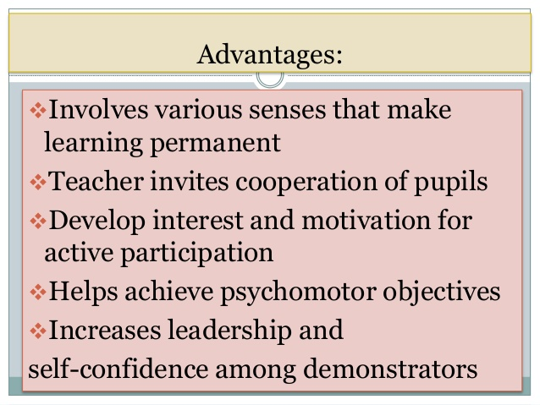

Slide 21
THANKS

