Slide 1
PEDAGOGY OF HISTORY
ASST.PROF:AMANDEEP KAUR

Slide 19
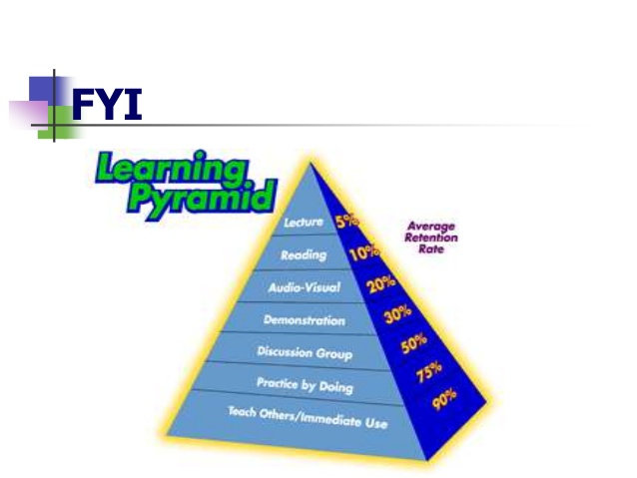

Slide 21
THANKS

