Slide 1
PEDAGOGY OF HISTORY
ASST.PROF.AMANDEEP KAUR

Slide 2
CONSTRUCTIVIST APPROACH

Slide 8
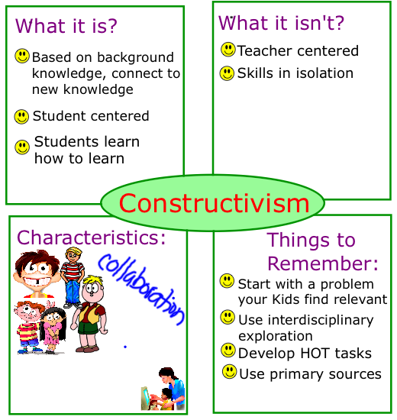

Slide 9
THANKS

