Slide 1
SADBHAVNA COLLEGE OF EDUCATION FOR WOMEN RAIKOT

Slide 2
Meaning of the Language

Slide 12
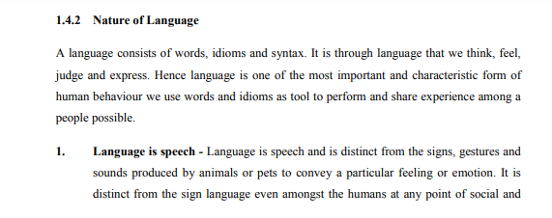

Slide 22
THANKS

