Slide 1
B.ED (SEM-I)
SUBJECT- ICT Skill Development
TOPIC- Nature and Advantages of Computer
Asst. Prof. MANPREET KAUR
SADBHAVNA COLLEGE OF EDUCATION FOR WOMEN, RAIKOT

Slide 2
Emails are easy to use and fast. We can send and receive electronic messages and save them on computers. They are delivered at once around the world. Emails can also have pictures in them. We can send birthday cards or newsletters as emails.
1. E-Mail

Slide 3
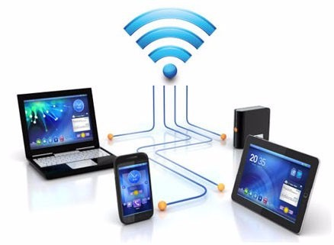
2. Connection with Internet
1. Connectivity, communication, and sharing
2. Information, knowledge, and learning
3. Address, mapping, and contact information.
4. Banking, bills, and shopping. .

Slide 4
3. Backup & Recovery
User can backup copies of work easily, without having to rewrite everything.
At any time it can be recover

Slide 5
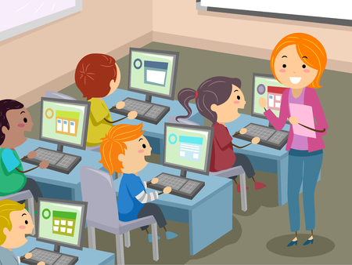
4. Education
Computer technology has had a deep impact on the education sector.
Thanks to computers, imparting education has become easier and much more interesting than before

Slide 6
5. New Skills
Because we live in a computer age, you often require basic computer skills to accomplish many daily tasks. Typing on a keyboard, using a mouse and other basic computer skills are useful in many different situations and are often required by employers.

Slide 7
THANK YOU

