Slide 1
Classification Of Computers

Slide 2
Classification of Computers
Microcomputers
2. Minicomputers
3. Mainframe computers
4. Supercomputers

Slide 3
Microcomputer =>Personal Computer => PC
There are 3 types of the Microcomputers :
  Laptop
  Desktop
  Workstation

Slide 4
Personal Computer: A small, single-user computer based on a microprocessor.
Workstation: A powerful, single-user computer. A workstation is like a personal computer, but it has :
  a more powerful microprocessor and,
  in general, a higher-quality monitor.

Slide 5
Minicomputer, Mainframe, and Supercomputer
Minicomputer: A multi-user computer capable of supporting up to hundreds of users simultaneously.
Mainframe: A powerful multi-user computer capable of supporting many hundreds or thousands of users simultaneously.
Supercomputer: An extremely fast computer that can perform hundreds of millions of instructions per second.

Slide 6
Minicomputers
Desk-sized
More processing speed and storage capacity than microcomputers
General data processing needs at small companies
Larger companies use them for specific purposes

Slide 7
Mainframe Computers
Larger machines with special wiring and environmental controls
Faster processing and greater storage than minicomputers
Typical machine in large organizations

Slide 8
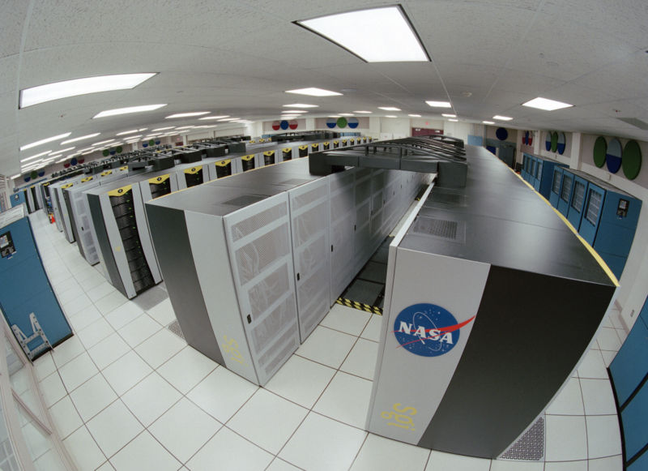
Supercomputers
The most powerful of the four categories
Used by very large organizations, particularly for very math-intensive types of tasks

Slide 9
Supercomputers

