Slide 2
FUNDAMENTAL RIGHTS

Slide 3
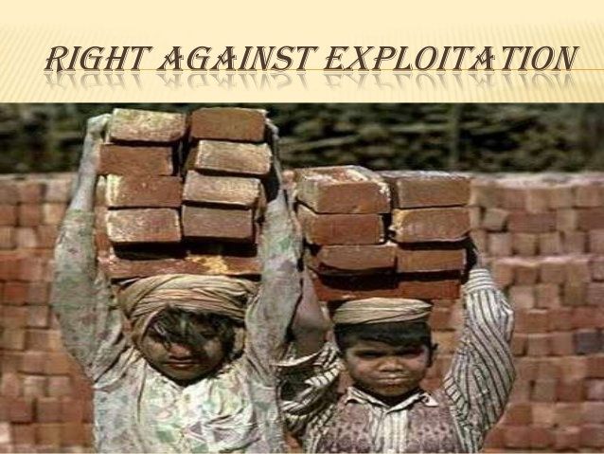

Slide 8
